Slide 1
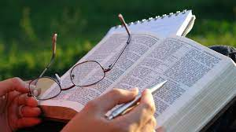
Studying the
Bible
Notes:
1

Slide 2

Quiz
Notes:
2

Slide 3

The Bible
Notes:
3

Slide 4
The Bible
Two Testaments
Old Testament – Before Jesus birth
New Testament – Jesus birth onward
Library of books
History
Law
Poetry
Prophercy
Many Authors
35 - 40 writers all inspired by one God
Time
Starts at the beginning of time - Creation
Continues beyond the present moment to the end – Second coming
Notes:
4

Slide 5

Why open & read the Bible?
B.I.B.L.E. ?
Basic Instructions Before Leaving Earth
Truth
In it we find truth it is no work of fiction
Relationship
It is Gods Word, it is living
Powerful
God Sword – Ephesians 6:17
Notes:
5

Slide 6
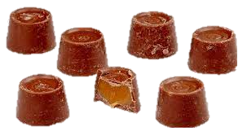
Rolo
Notes:
6

Slide 7
Rolo
Describe your Rolo experience.
Notes:
7

Slide 8


Why study the Bible?
Read or Study?
Reading is passive
Studying is partnering with God
Truth
Gods word helps us to understand truth, right and wrong
Relationship
Gods Word brings us closer to him, the more we know the more want
Understand God more
Food
Gods Word feeds the body and mind to growth
Powerful
God Sword – Ephesians 6:17
Two Edge Sword – Hebrews 4:12
Notes:
8

Slide 9
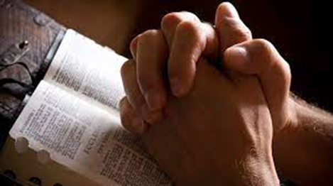

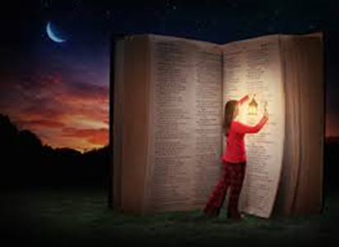
What can help us Study the Bible?
Gods Presence / drawing close to him
Worship
Worship music
Prayer
People
God/Holy Spirit
Minister / Teacher
Mature Christians
Other Followers
Books / Online
Concordance
Commentary’s
Devotionals
Other Christian books
Christian Literature – magazines, leaflets, newsletters etc
Notes:
9

Slide 10


How to Study the Bible
Pick your
Place
Time
Bible
Method
Be Prepared
Study needs
Human needs
Open
Heart
Mind
Pray
Before – Presence
During – Understanding, Revelation and Hearing
After – Application (changed heart, changed life)
Notes:
10

Slide 11

Methods for studying the Bible
Meditation
Journaling
Note Taking
5 W’s
Audience, Purpose, Context
Notes:
11

Slide 12

Meditation
Focus mind on verse or a small selection
Still or active
Set a period of time
Notes:
12

Slide 13


Go On, Have a Go
Meditation
Choose one of the two verses and meditate on it for 3 mins.
If you struggle to keep focus then light your candle or colour in the verse, whatever keeps you focused.
Write down anything that comes to mind as you meditate.
Notes:
13

Slide 14
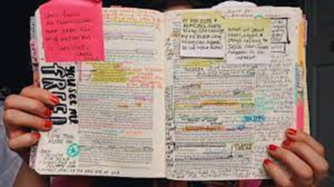
Journaling
What stands out?
Highlight
Underline
Write Out
What comes to mind?
Word
Picture
What is God saying
Notes:
14

Slide 15
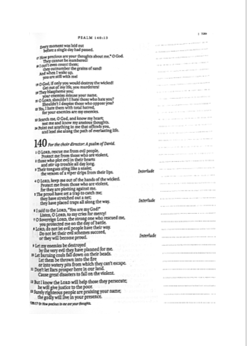
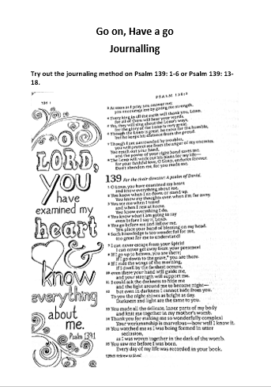
Go On, Have a Go
Journaling
Try out the journaling method on
Psalm 139: 1-6 or Psalm 139: 13-18.
Notes:
15

Slide 16

Note Taking
What verse or passage are you looking at?
What is happening?
What stands out?
What is significant?
Does it link with any other scripture?
What does it mean?
What is God saying?
Notes:
16

Slide 17
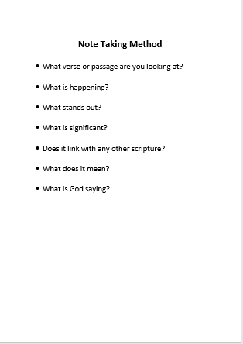
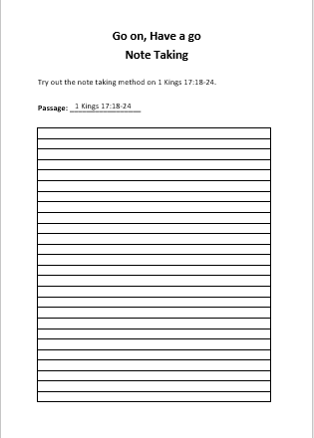
Go On, Have a Go
Note Taking
Try out the note taking method on
1 Kings 17:18-24.
Notes:
17

Slide 18
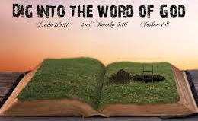
Who?
Who is involved in the passage?
Who is the author of the passage?
Who is the passage for?
5 W’s
What?
What is happening in the passage?
What is the relevance of where it is set or who is involved?
What is the message of the passage?
Where?
Where is the passage set – geographically, cultural setting?
Where is the passage in the bible? Is this significant?
When?
When is the passage set – dates, historical setting?
When is the time of day? Is it significant?
Why?
Why do the events in the passage take place?
Why is the passage written this way?
Why is the passage recorded? What is its purpose or message?
Notes:
18

Slide 19
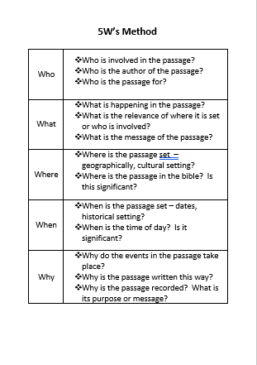
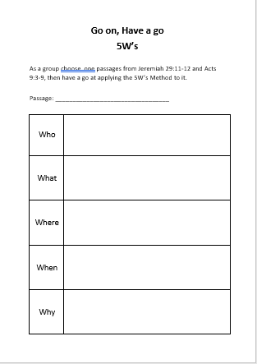
Go On, Have a Go
5W’s
As a group choose one passage from Jeremiah 29:11-12 or Acts 9:3-9, then have a go at applying the 5W’s Method to it.
Notes:
19

Slide 20

Audience, Context, Purpose
Audience
Who is the audience?
What do we know about the audience?
Context
Purpose
Notes:
20

Slide 21

Audience, Context, Purpose
Audience
Who is the audience?
What do we know about the audience?
Context
What is the context in which the passage is written?
What is the setting, physically, culturally, politically, spiritually, etc ?
Purpose
What was being said?
What did it mean to the people of the day?
What does it mean to us today?
Notes:
21

Slide 22
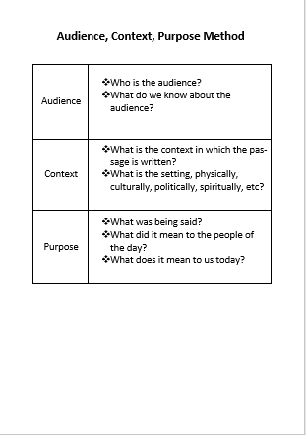
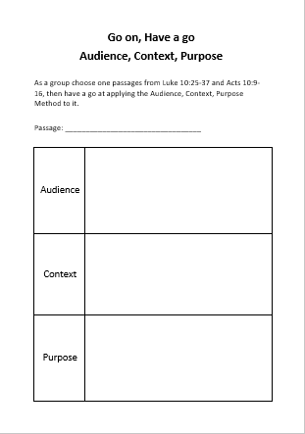
Go On, Have a Go
Audience, Context, Purpose
As a group choose one passages from Luke 10:25-37 or Acts 10:9-16,
then have a go at applying the Audience, Context, Purpose Method to it.
Notes:
22

Slide 23

Notes:
23

