Slide 1
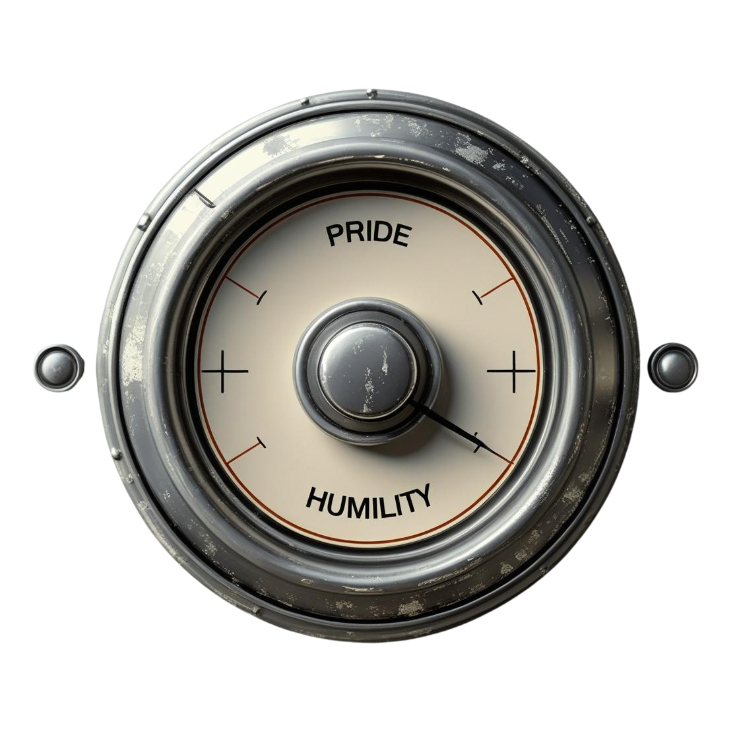

THIRST FOR HUMILITY
THIRST FOR
HUMILITY

Slide 2
THIRST FOR HUMILITY
What is your greatest achievement in life?

Slide 3
THIRST FOR HUMILITY
What does it mean to be humble?
Why is being humble important in our Christian walk?
How can we ‘turn up’ the humble and ‘turn down’ the pride in our everyday lives?

Slide 4
THIRST FOR HUMILITY
Pride’s for the ride. Humility’s for eternity.

Slide 5
THIRST FOR HUMILITY
What does it mean to be humble?

Slide 6
THIRST FOR HUMILITY
What does it mean to be humble?
“God opposes the proud, but shows favour to the humble.” Peter 4:6

Slide 7
THIRST FOR HUMILITY
What does it mean to be humble?
“²⁰ It is what comes from inside that defiles you. ²¹ For from within, out of a person’s heart, come evil thoughts, sexual immorality, theft, murder, ²² adultery, greed, wickedness, deceit, lustful desires, envy, slander, pride, and foolishness. ²³ All these vile things come from within; they are what defile you.”
Mark 7:20-23

Slide 8
THIRST FOR HUMILITY
What does it mean to be humble?
Humble: adjective
not proud or arrogant; modest
having a feeling of insignificance, inferiority, subservience, etc.

Slide 9
THIRST FOR HUMILITY
What does it mean to be humble?
So let us come BOLDLY to the throne of our gracious God. There we will receive His mercy, and we will find grace to help us when we need it most.
Hebrews 4:16

Slide 10
THIRST FOR HUMILITY
What does it mean to be humble?
Humility has nothing to do with intelligence or competence.
It’s about attitude.

Slide 11
THIRST FOR HUMILITY
What does it mean to be humble?
Humility says: “I am completely dependent on YOU God, and I’m going to use YOUR strength to serve others.”

Slide 12
THIRST FOR HUMILITY
What does it mean to be humble?
God “has no use for conceited people, but shows favour to those who are humble.”
Proverbs 3:34

Slide 13
THIRST FOR HUMILITY
What does it mean to be humble?
Reflection
1. Can you think of some examples of humility from scripture? / from culture?
2. Reflecting on your ‘greatest achievement in life’ – where was God in that situation?

Slide 14
THIRST FOR HUMILITY
Why is humility important in our Christian walk?

Slide 15
THIRST FOR HUMILITY
Why is humility important in our Christian walk?
“Whoever exalts himself will be
humbled,
and whoever humbles himself
will be exalted.”

Slide 16
THIRST FOR HUMILITY
Why is humility important in our Christian walk?
“Do nothing out of selfish ambition or vain conceit. Rather, in humility value others above yourselves”
Phil 2:3

Slide 17
THIRST FOR HUMILITY
Why is humility important in our Christian walk?
“clothe yourselves with humility toward one
another”

Slide 18
THIRST FOR HUMILITY
Why is humility important in our Christian walk?
HUMILITY is a must-have qualification if you’re applying for the job of disciple

Slide 19
THIRST FOR HUMILITY
Why is humility important in our Christian walk?
Reflection
1.What does it mean to “clothe yourself in humility”?
2. What would it look like to obey this command?
3. Can you think of a scenario in the last week where you did this well and another in which you didn’t do this well?

Slide 20
THIRST FOR HUMILITY
How can we ‘turn up’ the humble and ‘turn down’ the pride in our everyday lives?

Slide 21
THIRST FOR HUMILITY
How can we ‘turn up’ the humble and ‘turn down’ the pride in our everyday lives?
1. Look at ourselves through Gods eyes
“Humble yourselves before the Lord, and he will exalt you” James 4:10

Slide 22
THIRST FOR HUMILITY
How can we ‘turn up’ the humble and ‘turn down’ the pride in our everyday lives?
“Take my yoke upon you and learn from me, for I am gentle and humble in heart, and you will find rest for your souls.” Matthew 11:29

Slide 23
THIRST FOR HUMILITY
How can we ‘turn up’ the humble and ‘turn down’ the pride in our everyday lives?
2. Look at others through
God’s eyes
“A new commandment I give to you, that you love one another: just as I have loved you, you also are to love one another”
John 13:34

Slide 24
THIRST FOR HUMILITY
How can we ‘turn up’ the humble and ‘turn down’ the pride in our everyday lives?
3. Look at ministry through God’s eyes
“I have fought the good fight, I have finished the race, I have kept the faith.”
2 Timothy 4:7

Slide 25
THIRST FOR HUMILITY
How can we ‘turn up’ the humble and ‘turn down’ the pride in our everyday lives?
Reflection – discuss these statements
1. True humility is complete dependence on God
2. A truly humble person sees themselves as less than or a servant to others
3. True humility is complete obedience to God’s word

