Slide 1

THIRST
Ps 63:1-8
Thirst: Spiritual Warfare
Part 1: Know Your Enemy

Slide 2
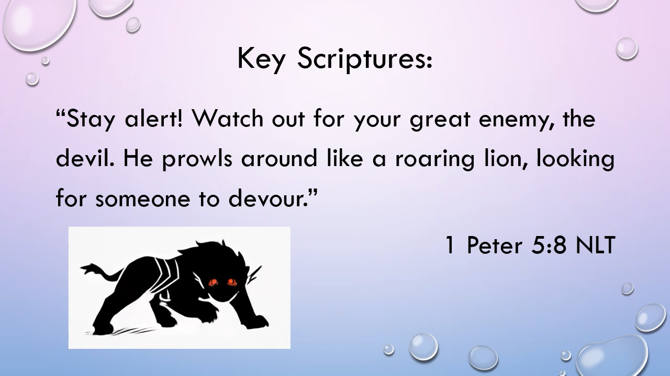

Slide 3
Spiritual Warfare Seriously?

Slide 4
Key Scriptures:‬‬‭‭
“For we are not fighting against flesh-and-blood enemies, but against evil rulers and authorities of the unseen world, against mighty powers in this dark world, and against evil spirits in the heavenly places.”
Ephesians ‬ ‭6‬:‭812 ‭NLT

Slide 5

Spiritual Warfare‬‬‭‭ Seriously?

Slide 6
Who is our God?

Slide 7
God is the uncreated creator and ultimate authority. (1 Timothy 6:15)
God wins! (Revelation)
God’s children have the Holy Spirit. (1 John 4:4)
God created angels to worship and serve Him. (Hebrews 1:14)

Slide 8

Spiritual Warfare
Knowing that the ending is already written (Jesus wins), how does that change the way you live your day-to-day life?
How have angels helped or fought for you on your journey with God?

Slide 9
Who is the Enemy?

Slide 10
Satan’s Names/Titles
Satan means adversary. (Matthew 4:10)
Devil means slanderer. (Matthew 4:1)
He is called…
Beelzebul/Beelzebub. (Matthew 12:24)
Serpent. (Genesis 3:1)

Slide 11
Satan’s Names/Titles
Morning star/Lucifer (Isaiah 14:12)
Dragon. (Revelation 12:9)
The evil one. (Matthew 13:19)
The ruler of this world. (John 12:31)
The god of this world. (2 Corinthians 4:4)

Slide 12
Satan’s Names/Titles
The accuser of believers. (Revelation 12:10)
The father of lies. (John 8:44)
The deceiver of this world. (Revelation 12:9)

Slide 13
Satan’s Perfection
Satan, created by God, was originally good. (Colossians 1:16)

Slide 14
Satan’s Perfection
Satan, created by God, was originally good. (Colossians 1:16)
God deemed His creation, including Satan, as very good. (Genesis 1:31)

Slide 15
Satan’s Position
Has access to God’s throne.
Present in the Garden of Eden.
Describes him as being perfect from the day he was created, beautiful, full of wisdom.
Refers to this being as an anointed cherub.
(Ezekiel 28:12-14 NKJV)

Slide 16
Satan’s Pride‬‬‭‭
Satan's pride led him from a blameless state to one of wickedness and violence.
(Ezekiel 28:15-17 NLT)

Slide 17
Satan’s Pride‬‬‭‭
Ascending into heaven
Raising his throne above the stars of God
Sitting enthroned on the mount of assembly
Ascending above the clouds
Making himself like the Most High
(Isaiah 14:12-14 NKJV)

Slide 18
Satan’s Pride
The consequence of Satan’s prideful rebellion was that he was cast down from heaven…
“… I saw Satan fall from heaven like lightning!”
(Luke 10:17-18 NLT)

Slide 19
Satan’s Persuasion
Satan orchestrated a rebellion against God and persuaded one-third of the angels to join him.
(Revelation 12:3-4 NLT)

Slide 20
Satan’s Place
A place was created for Satan and his demons that we have come to know as hell. Revelation describes the time when they will be thrown in the fiery lake forever.
(Matthew 25:41 NLT)

Slide 21
Know Your Enemy
Satan’s pride ultimately resulted in his destruction. What lessons can we learn from this?
(Proverbs 16:8, James 4:6)

Slide 22
Know Your Enemy
Why would God create Satan if He foreknew that he would rebel?

Slide 23
Know the Strategies

Slide 24
Know the Strategies
The earlier Christians were fully aware of how the enemy works and so we need to be also.
“… For we are familiar with his evil schemes.”
(2 Corinthians 2:11 NLT)

Slide 25
Know the Strategies
He tempts. (Jesus – Matthew 4/Luke 4. Peter – Luke 22:31)

Slide 26
Know the Strategies
He tempts. (Jesus – Matthew 4/Luke 4. Peter – Luke 22:31)
He disguises himself as an angel of light. (2 Corinthians 11:14)

Slide 27
Know the Strategies
He tempts. (Jesus – Matthew 4/Luke 4. Peter – Luke 22:31)
He disguises himself as an angel of light. (2 Corinthians 11:14)
He blinds the minds of unbelievers to the gospel. (2 Corinthians 4:4)

Slide 28
Know the Strategies
He uses lies and twisted half truths. (Genesis 3:4-5, John 8:44)

Slide 29
Know the Strategies
He uses lies and twisted half truths. (Genesis 3:4-5, John 8:44)
He turns nations against each other and attempts to set them against God.

Slide 30
Know the Strategies
He uses lies and twisted half truths. (Genesis 3:4-5, John 8:44)
He turns nations against each other and attempts to set them against God.
He divides the church. (2 Corinthians 2:7-10, Acts 20, Galatians 4)

Slide 31
Know the Strategies
He attacks the meaning of love. (Genesis 2:24, Matthew 19:4-6)

Slide 32
Know the Strategies
He attacks the meaning of love. (Genesis 2:24, Matthew 19:4-6)
He has misled people into believing that God causes death and sickness. (John10:10)

Slide 33
Know the Strategies
He attacks the meaning of love. (Genesis 2:24, Matthew 19:4-6)
He has misled people into believing that God causes death and sickness. (John10:10)
He attempts to stop the work of the church and delay God’s answers to prayers. (Daniel 10:13)

Slide 34
What can we do?

Slide 35
What can we do?
Step 1 - Pray.
Call upon the name of the Lord. Read Psalm 46:1, Psalm 34:17, Psalm 69:33, and Psalm 116.

Slide 36
What can we do?
Step 2 - Remember.
Remember these two promises from God:
“. .. the Spirit who lives in you is greater than the spirit who lives in the world.”‭‭
1 John‬ ‭4‬:‭4‬ ‭NLT

Slide 37
What can we do?
Step 2 - Remember.
Remember these two promises from God
‬‬“So humble yourselves before God. Resist the devil, and he will flee from you.”
‭‭James‬ ‭4‬:‭7‬ ‭NLT‬‬

Slide 38
What can we do?
Step 3 - Wield the Word of God.
Our Father has given us everything we need in His Word. Be well-prepared. Have enough Scripture ready.‬‬

