Slide 1


Slide 2
IT IS MORE BLESSED TO GIVE THAN TO RECEIVE
ACTS 20:35

Slide 3
² They are being tested by many troubles, and they are very poor. But they are also filled with abundant joy, which has overflowed in rich generosity.
³ For I can testify that they gave not only what they could afford, but far more. And they did it of their own free will. ⁴ They begged us again and again for the privilege of sharing in the gift for the believers in Jerusalem.
2 CORINTHIANS 8:2 TO 4 nlt

Slide 4
Since you excel in so many ways—in your faith, your gifted speakers, your knowledge, your enthusiasm, and your love from us — I want you to excel also in this gracious act of giving.
2 CORINTHIANS 8:7 nlt

Slide 5


Slide 6
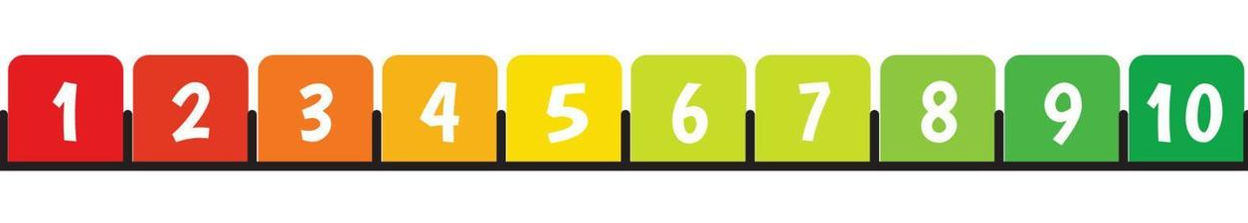
Where would you put yourself on the GENEROUSometer?

Slide 7
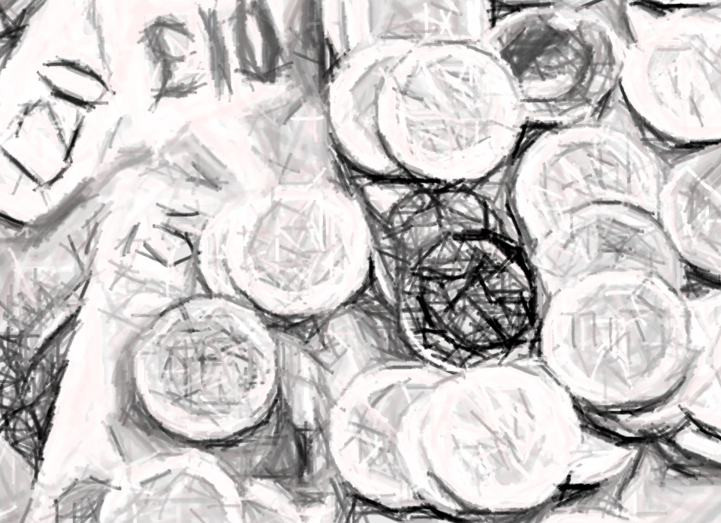
When someone has been irrationally generous, what should we be doing in the community to give back and share God’s love?

Slide 8
Therefore, whenever we have the opportunity, we should do good to everyone — especially to those in the family of faith.
GALATIANS 6:10 nlt

Slide 10
1. Sport AND related activity
2. Community activity
3. Inter generational

