Slide 1


Slide 2


Slide 3


Slide 4
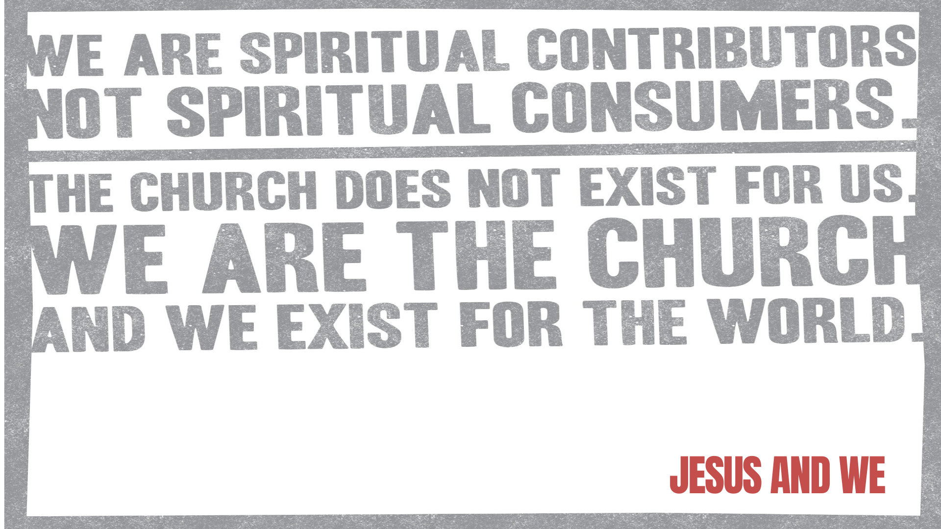

Slide 5
³¹ Meanwhile, the disciples were urging Jesus, “Rabbi, eat something.”
³² But Jesus replied, “I have a kind of food you know nothing about.”
³³ “Did someone bring him food while we were gone?” the disciples asked each other.
³⁴ Then Jesus explained: “My nourishment comes from doing the will of God, who sent me, and from finishing his work.
JOHN 4:31 TO 34 NLT

Slide 6


Slide 7
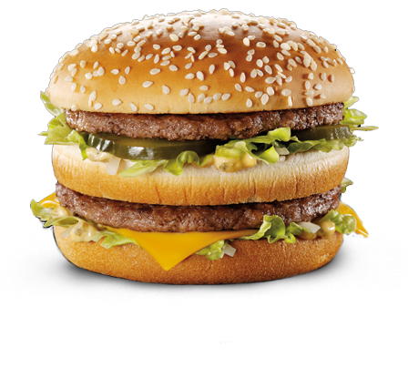

Slide 8
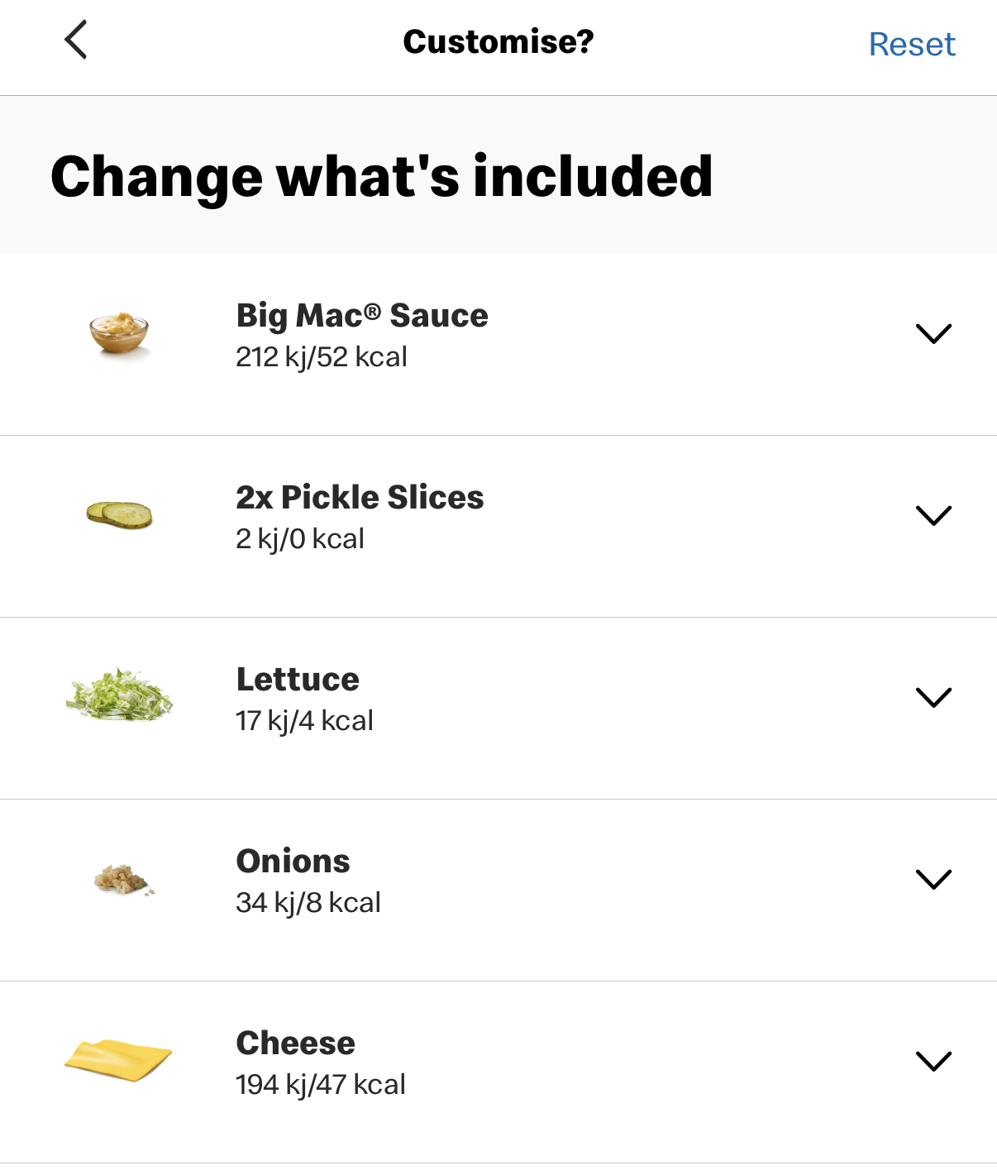
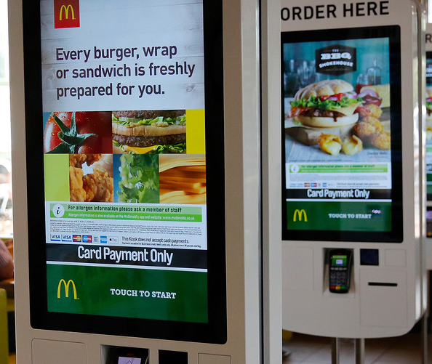

Slide 10
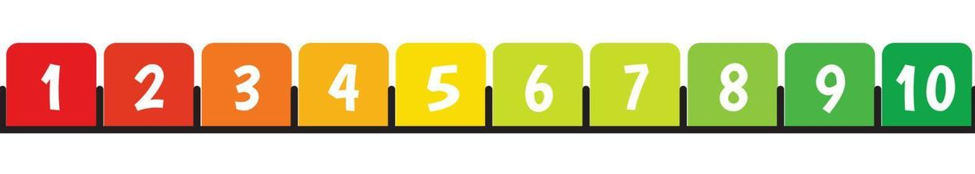
Where would you put yourself on the CONTRIBUTometer?

Slide 11

GOD CALLS YOU TO SERVE IN HIS CHURCH
FOR THE HOLY ONE HAS GIVEN YOU HIS SPIRIT 1 JOHN 2:20 NLT

Slide 12
“6 In His grace, God has given us different gifts for doing certain things well.”
Prophecy, serving, teaching,
encouragement, giving, leading AND KINDNESS
ROMANS 12:6 NLT

Slide 13
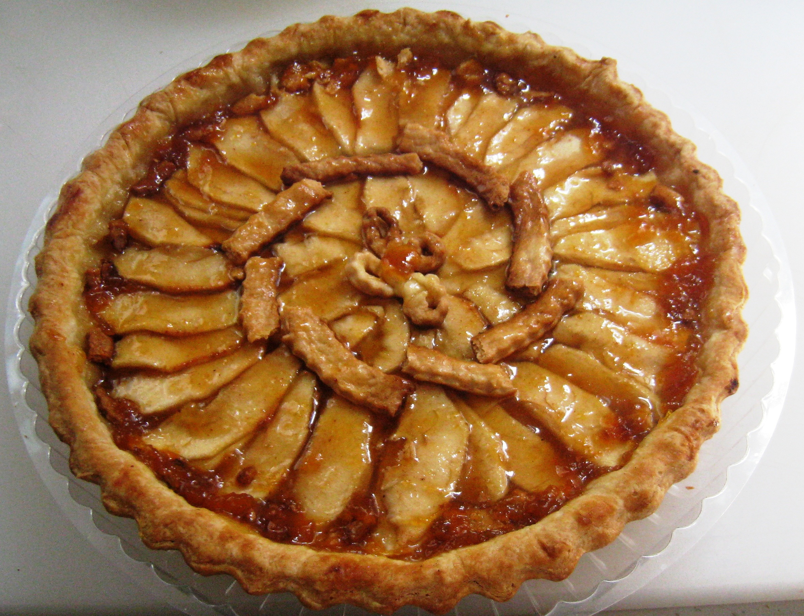

Slide 14
God wants you to use your gifts in the Church to minister to people for His glory.

Slide 15
GOD CALLS YOU TO SERVE AS HIS CHURCH

Slide 16
¹⁴ “You are the light of the world — like a city on a hilltop that cannot be hidden. ¹⁵ No one lights a lamp and then puts it under a basket. Instead, a lamp is placed on a stand, where it gives light to everyone in the house. ¹⁶ In the same way, let your good deeds shine out for all to see, so that everyone will praise your heavenly Father.”
MATTHEW 14 TO 16 NLT

