Slide 1


Slide 2


Slide 3


Slide 4


Slide 5

Go THEREFORE AND MAKE DISCISPLES OF ALL NATIONS, BAPTIZING THEM IN THE NAME OF THE FATHER AND OF THE SON AND OF THE HOLY SPIRIT.
MATTHEW 28:19 NLT

Slide 6



Slide 7
“Healthy people do NOT need a doctor—sick people do. I have come to call not those who think they are righteous, but those who know they are sinners.”
MARK 2:17 NLT

Slide 8
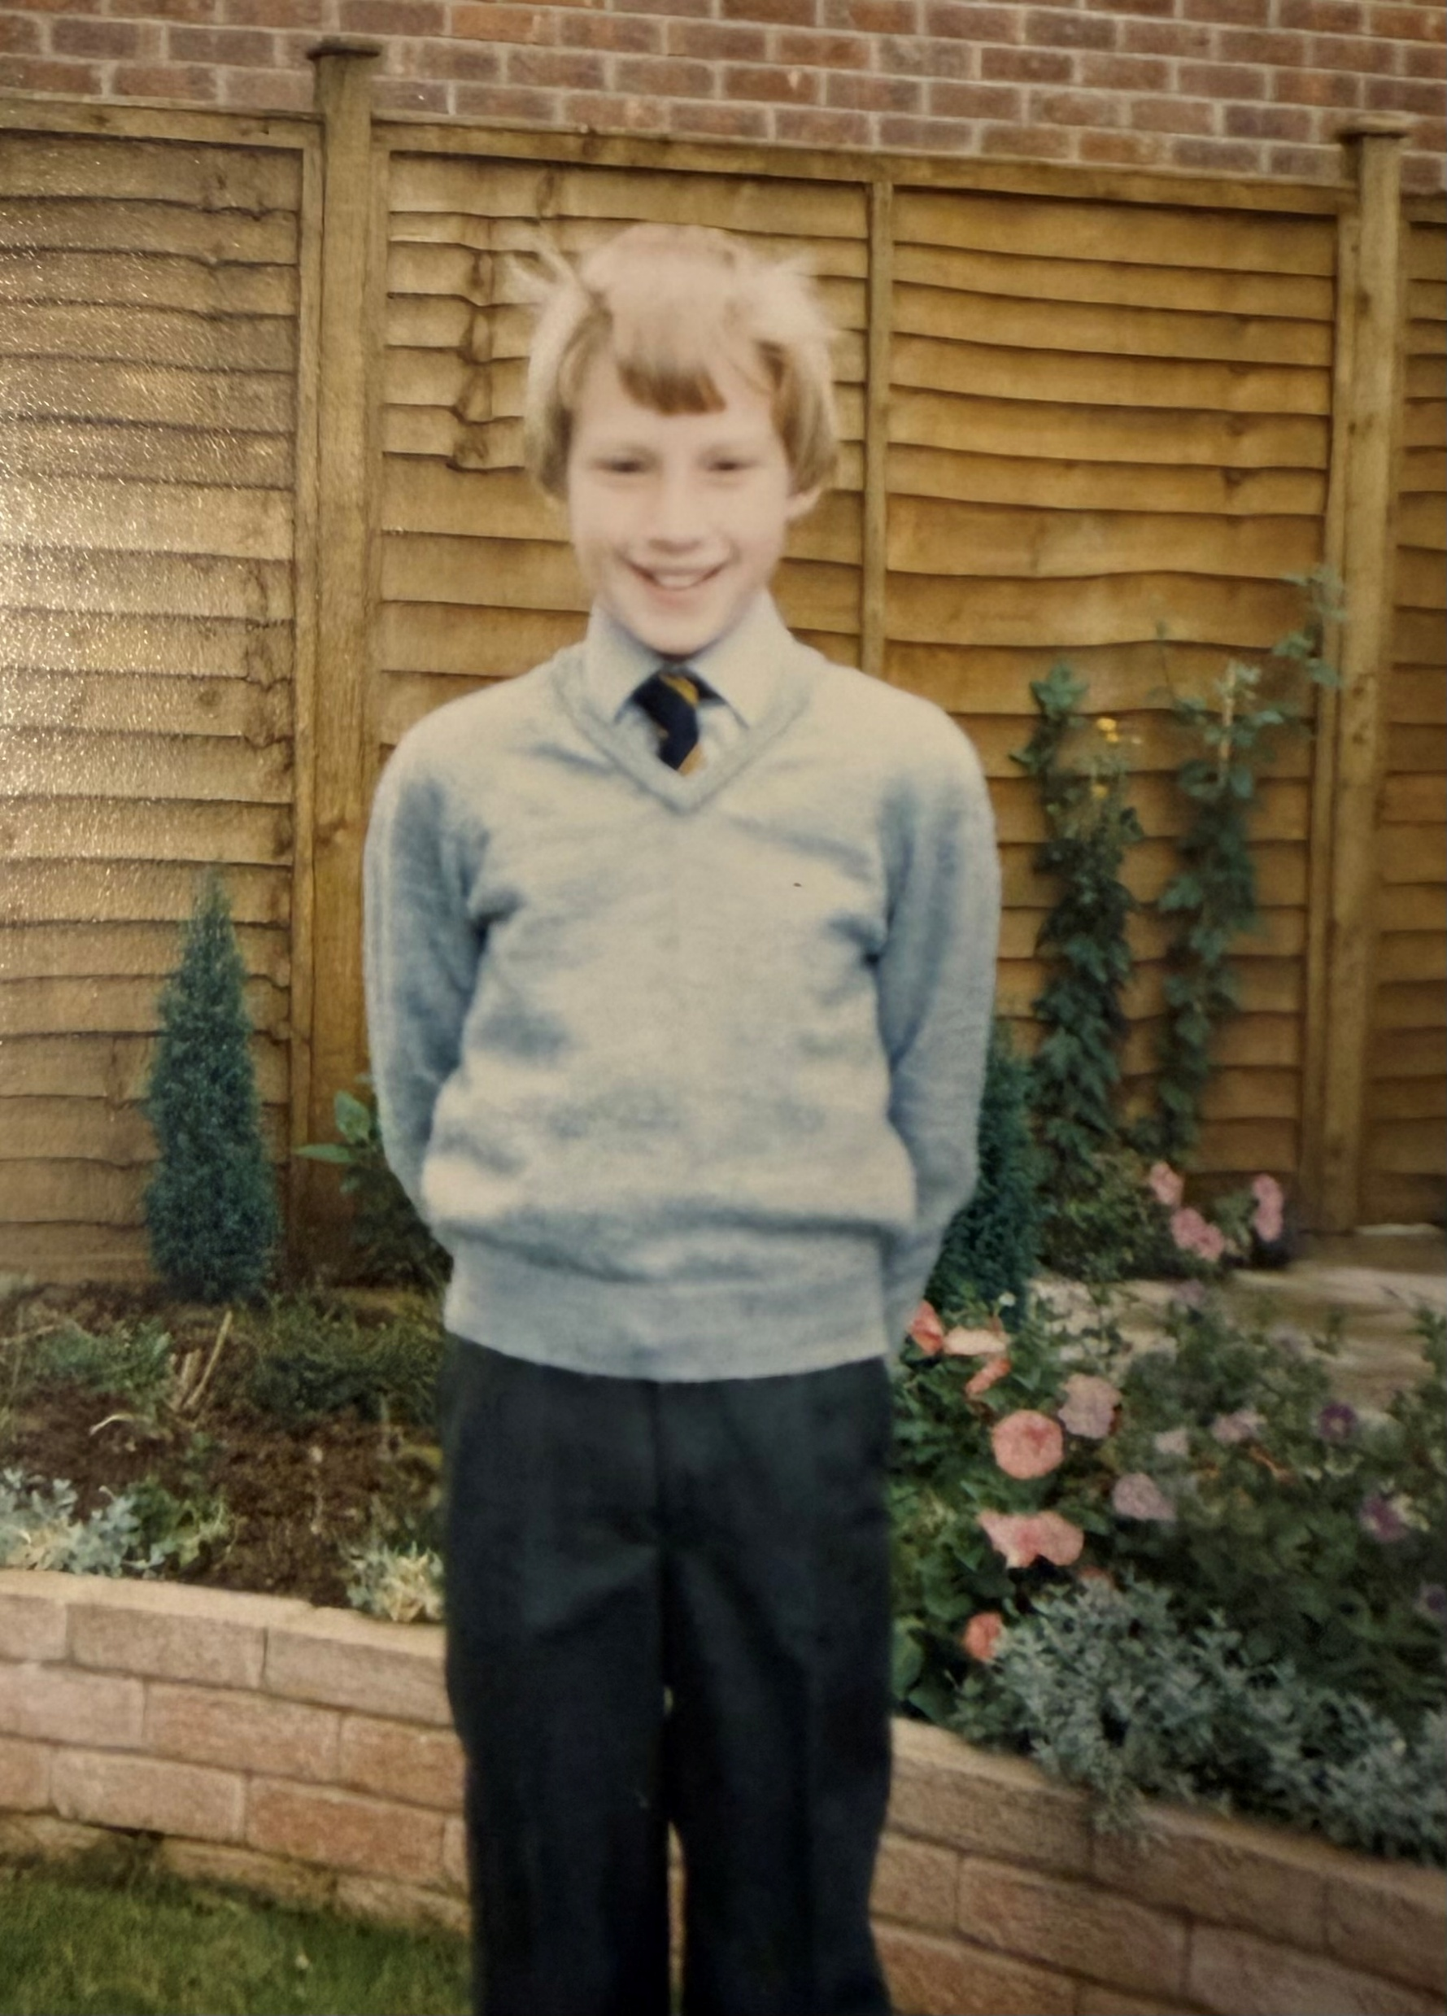
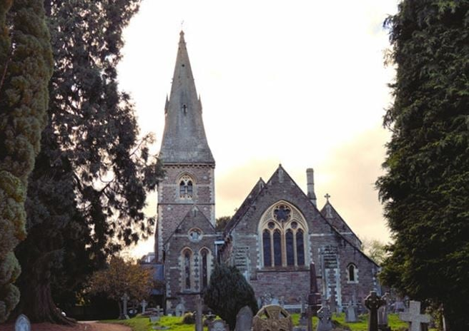

Slide 10
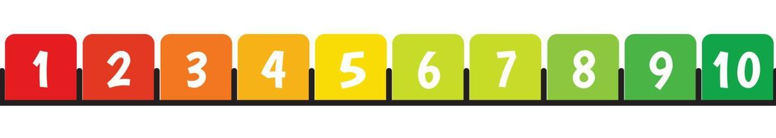
Where would you put yourself on the DISCIPLESHIPometer?

Slide 11
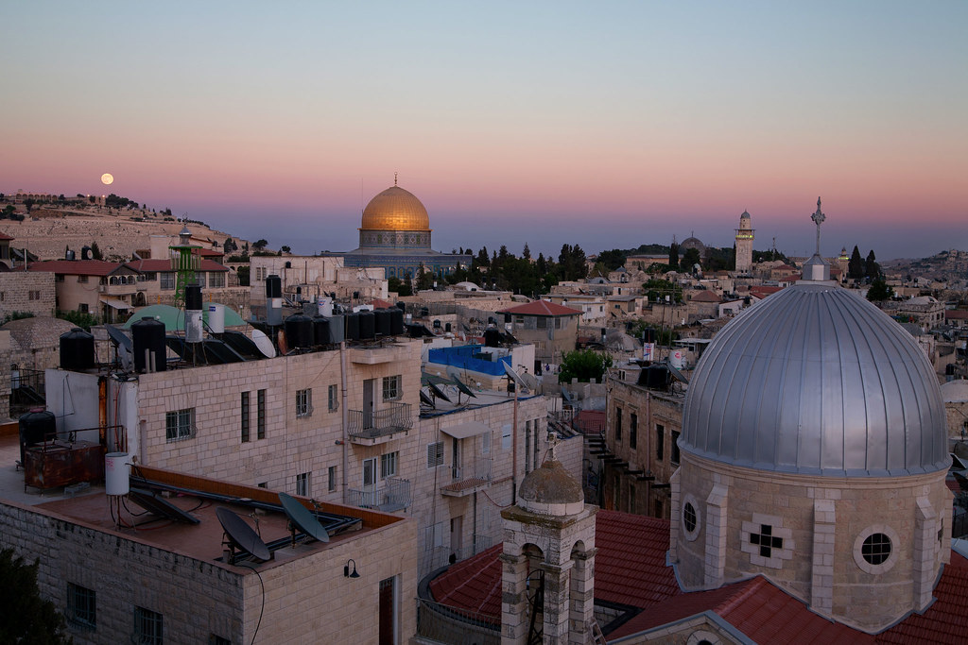
A few days later, when Jesus again entered Capernaum, the people heard that he had come home. They gathered in such large numbers that there was no room left, not even outside the door, and he preached the word to them.
Some men came, bringing to him a paralyzed man, carried by four of them.
MARK 2:1 TO 5 NIV

Slide 12
Since they could not get him to Jesus because of the crowd, they made an opening in the roof above Jesus by digging through it and then lowered the mat the man was lying on. When Jesus saw their faith, he said to the paralyzed man, “Son, your sins are forgiven.”
MARK 2:1 TO 5 NIV

Slide 13
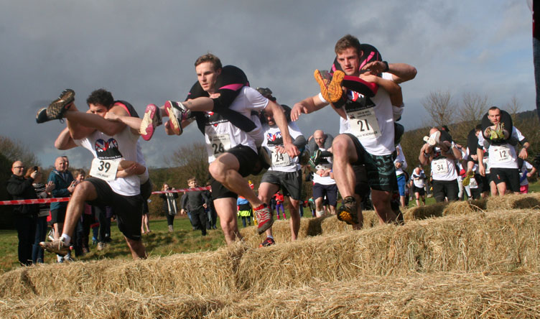
WE NEED TO BEAR SOME
BURDENS
SOME MEN CAME BRINGING TO him A PARALYSED MAN, CARRIED BY FOUR OF THEM.
Mark 2:3 NIV

Slide 14
People do not care how much you know
they want to know how much you care

Slide 15

GOD IS GOING TO CALL US TO BREAK SOME RULES
they made an opening in the roof above Jesus by digging through it.
Mark 2:4 NIV

Slide 16
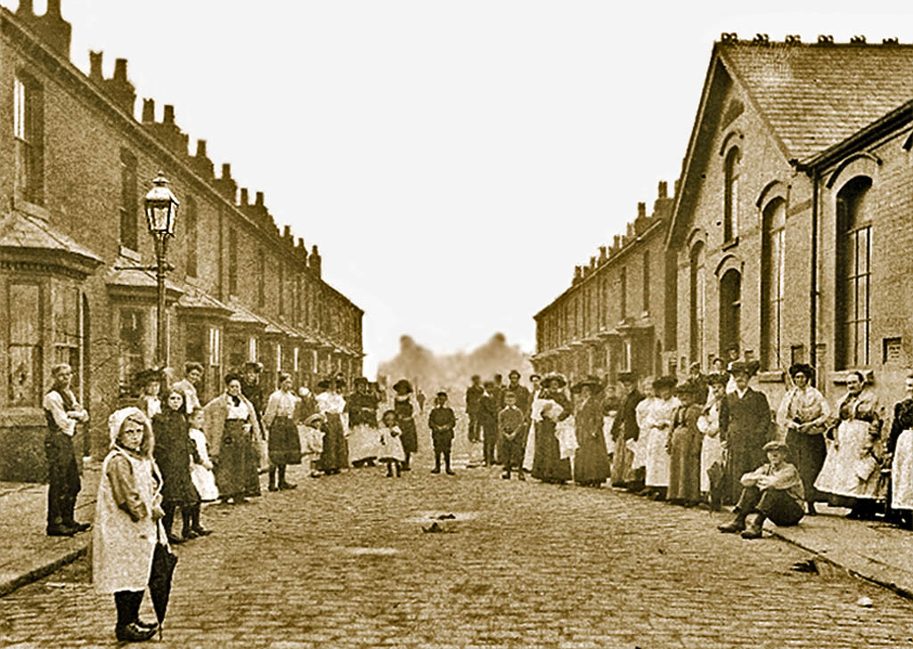
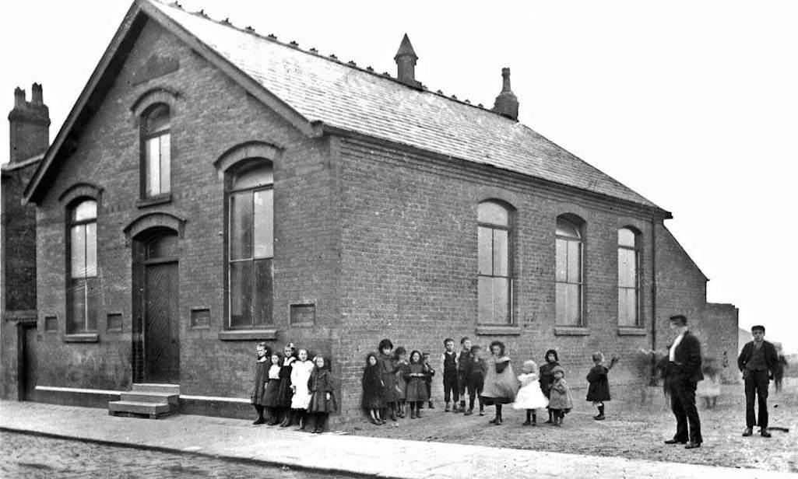
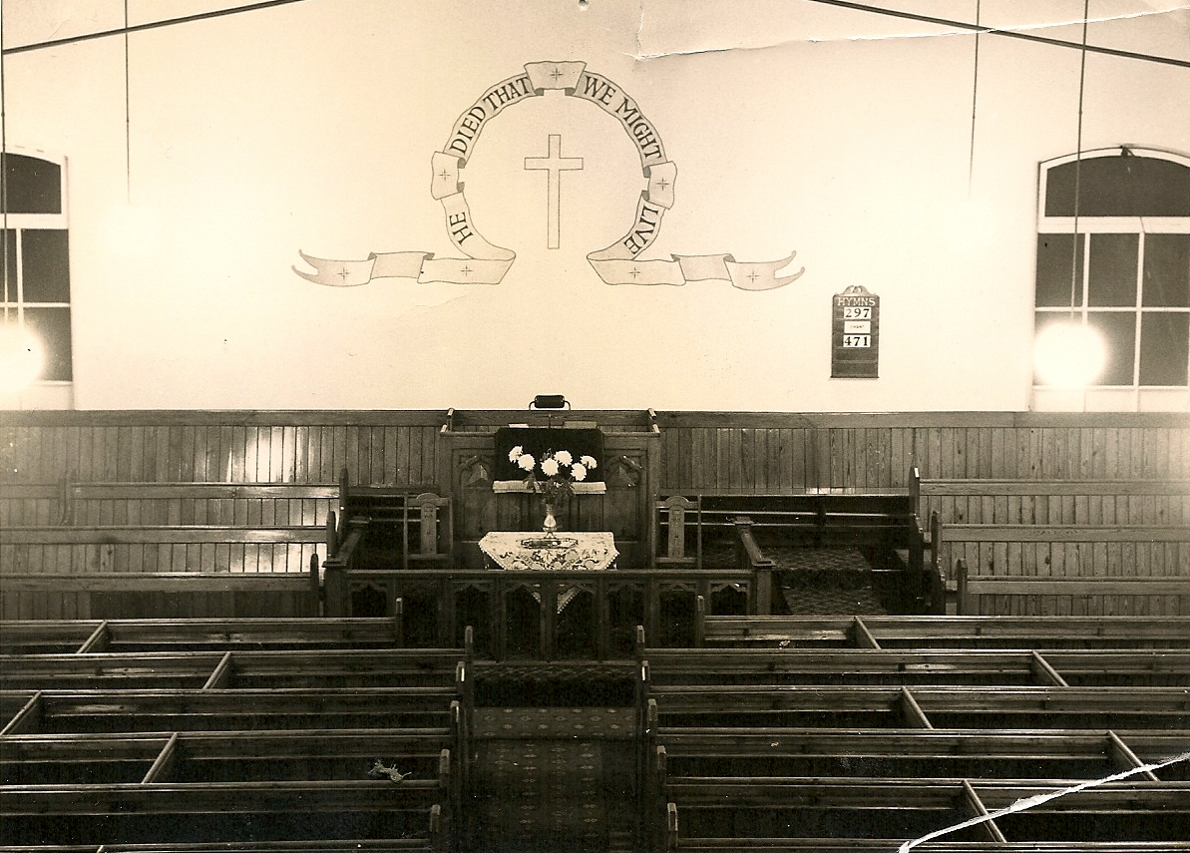

Slide 18
God has given each of you a gift from his great variety of spiritual gifts. Use them well to serve one another.
1 Peter 4:10 NLT

