Slide 1


Slide 2
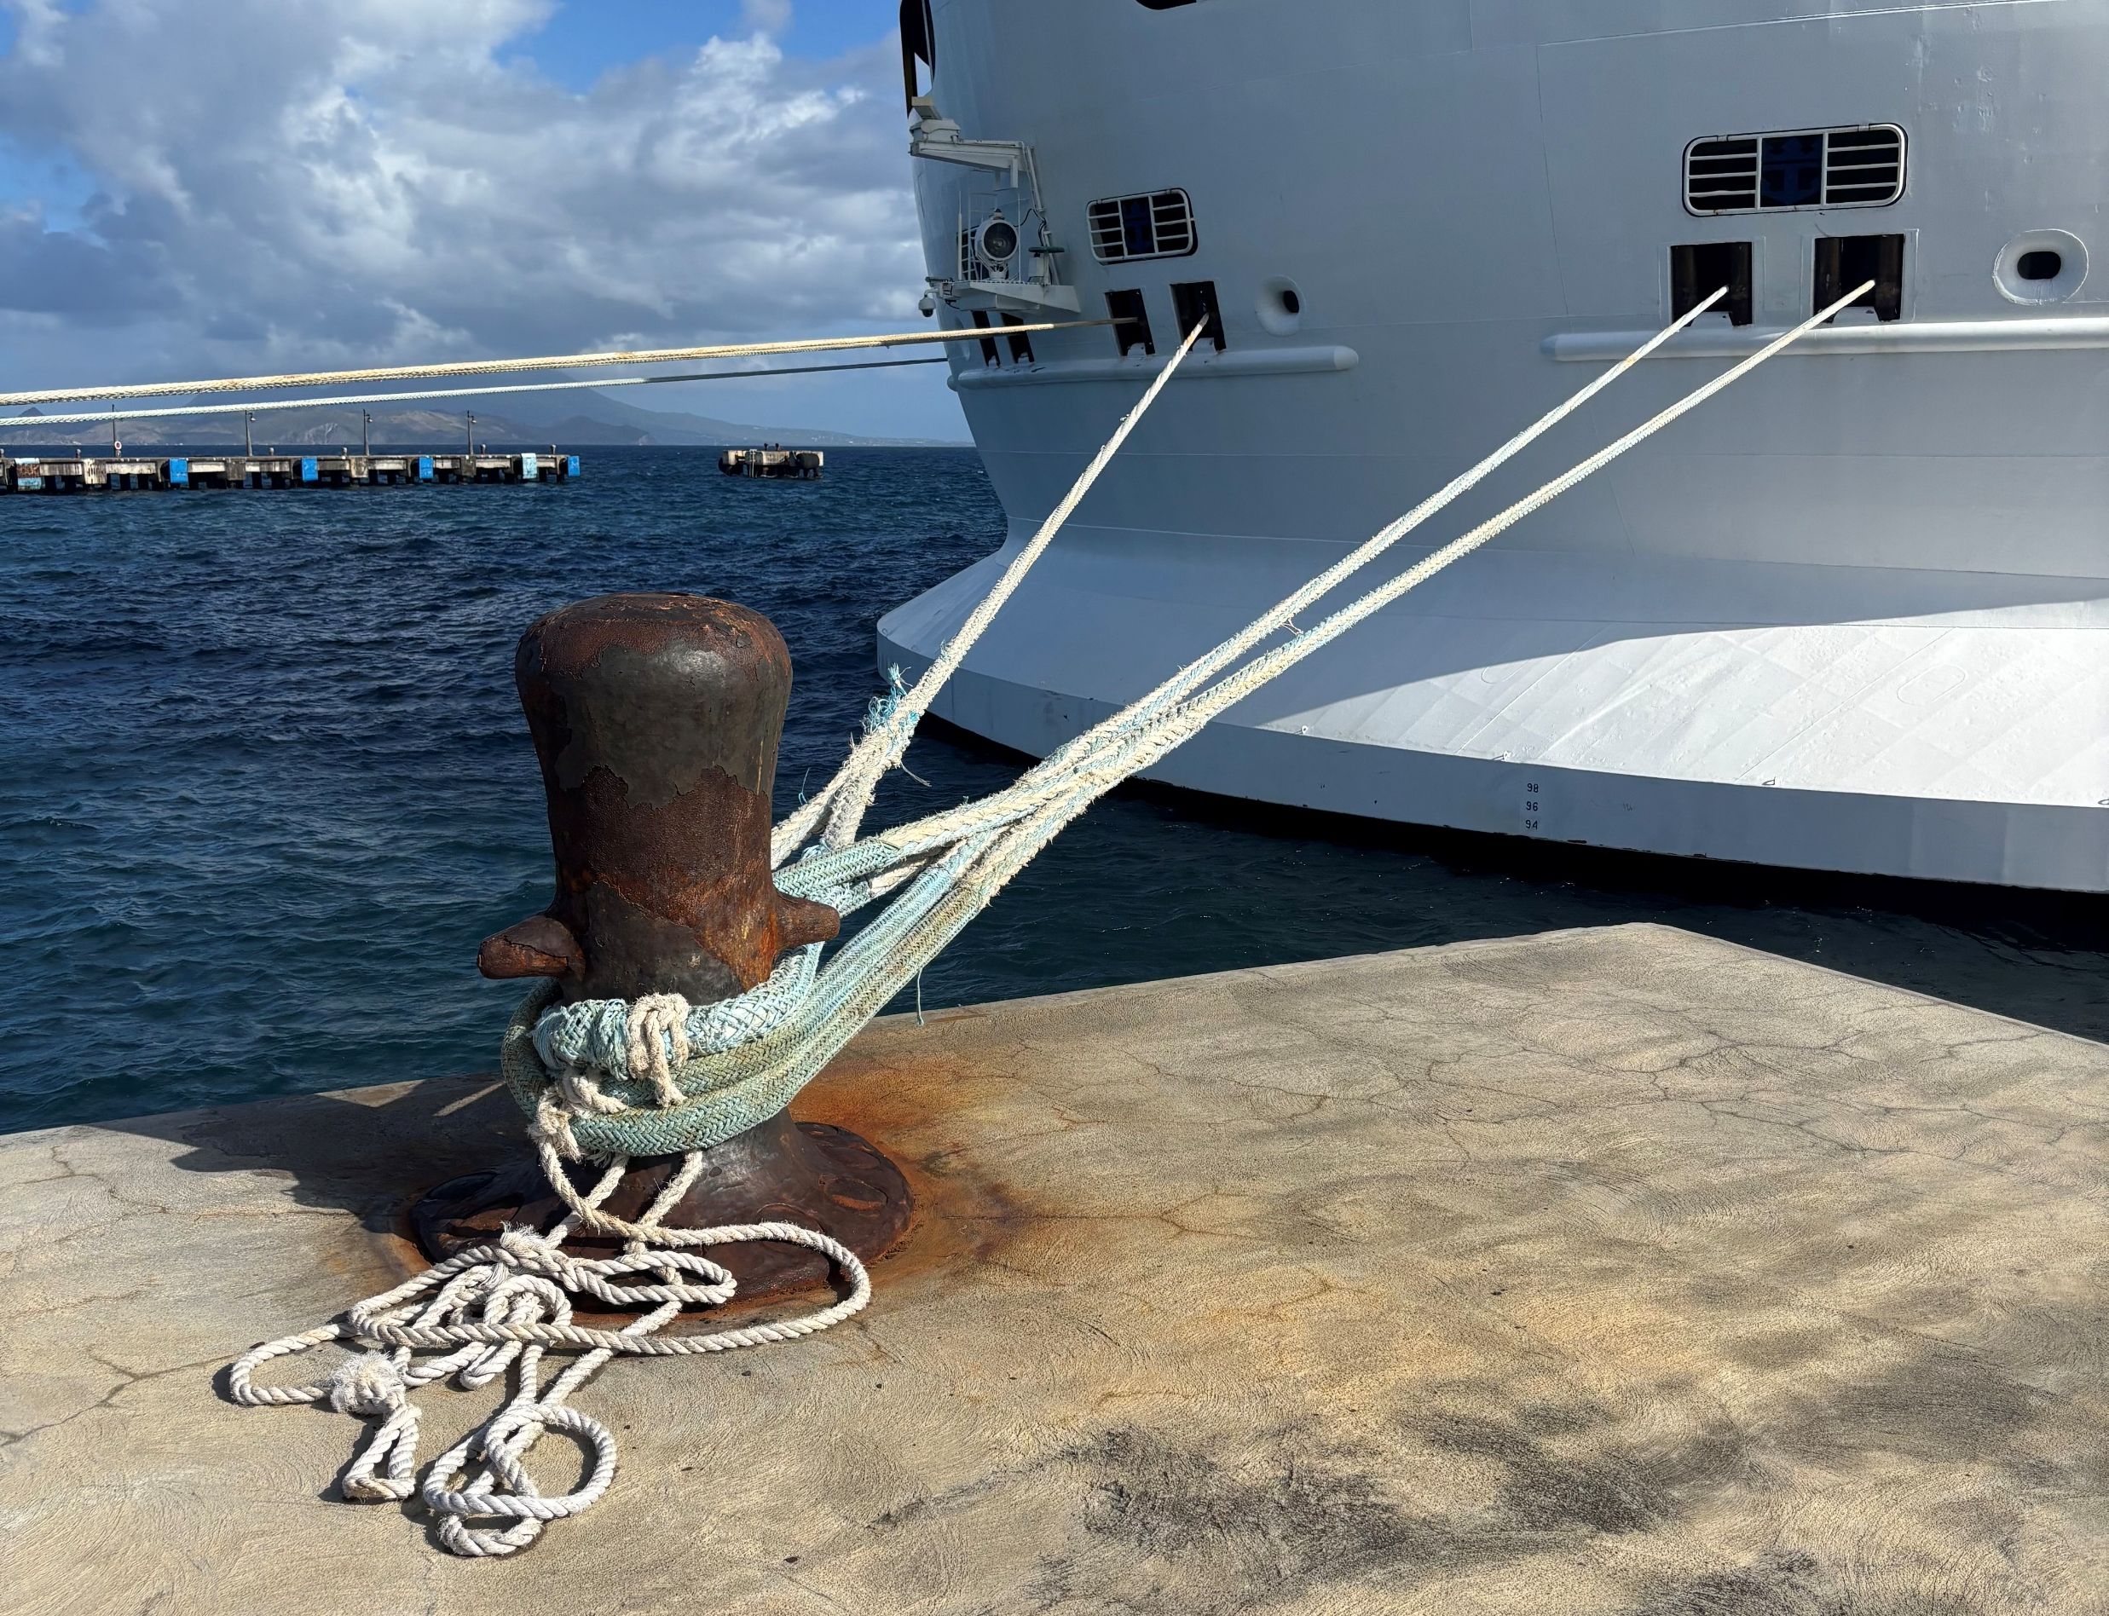

Slide 3
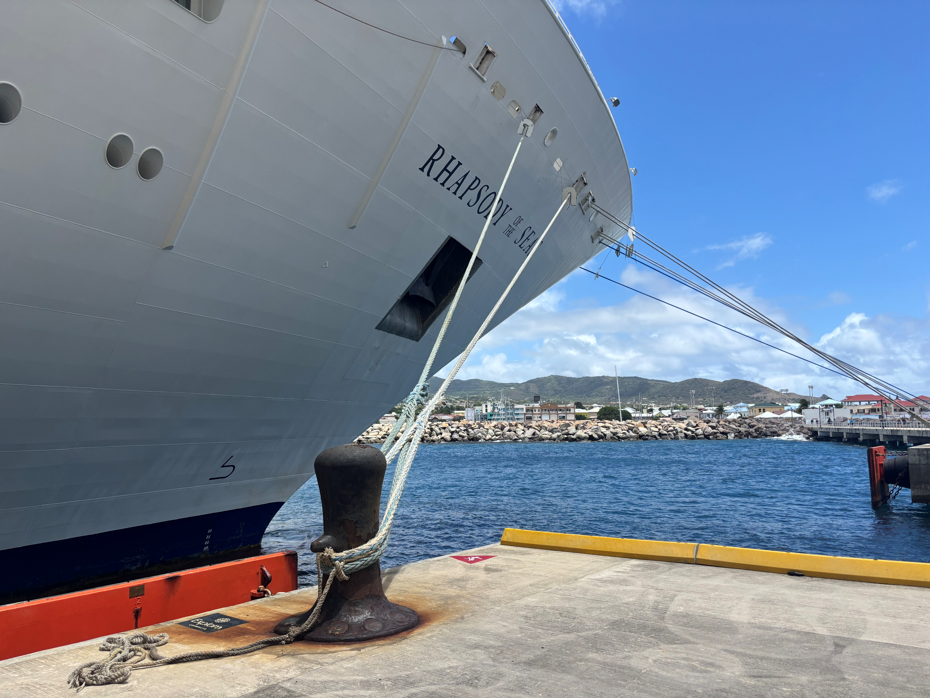
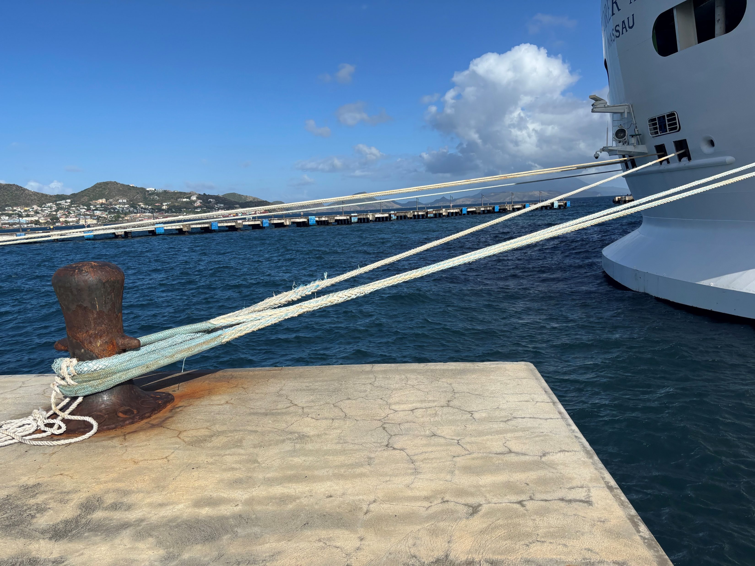

Slide 6


Slide 7
¹ Jesus left that part of the country and returned with his disciples to Nazareth, his hometown. ² The next Sabbath he began teaching in the synagogue, and many who heard him were amazed. They asked, “Where did he get all this wisdom and the power to perform such miracles?” ³ Then they scoffed, “He is just a carpenter, the son of Mary and the brother of James, Joseph, Judas, and Simon. And his sisters live right here among us.” They were deeply offended and refused to believe in him.

Slide 8
Then Jesus told them, “A prophet is honored everywhere except in his own hometown and among his relatives and his own family.” ⁵ And because of their unbelief, he could not do any miracles among them except to place his hands on a few sick people and heal them.
⁶ And he was amazed at their unbelief.
MARK 6: 1 to 6 nlt

Slide 9
⁶ “Lord, do not trouble yourself by coming to my home, for I am not worthy of such an honor. ⁷ I am not even worthy to come and meet you. Just say the word from where you are, and my servant will be healed…
⁹ When Jesus heard this, he was amazed. Turning to the crowd that was following him, he said, “I tell you, I have not seen faith like this in all Israel” Luke 7: 6 to 9 nlt

Slide 11
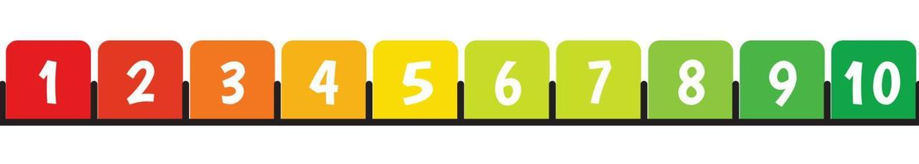
Where would you put yourself on the faithometer?

Slide 12
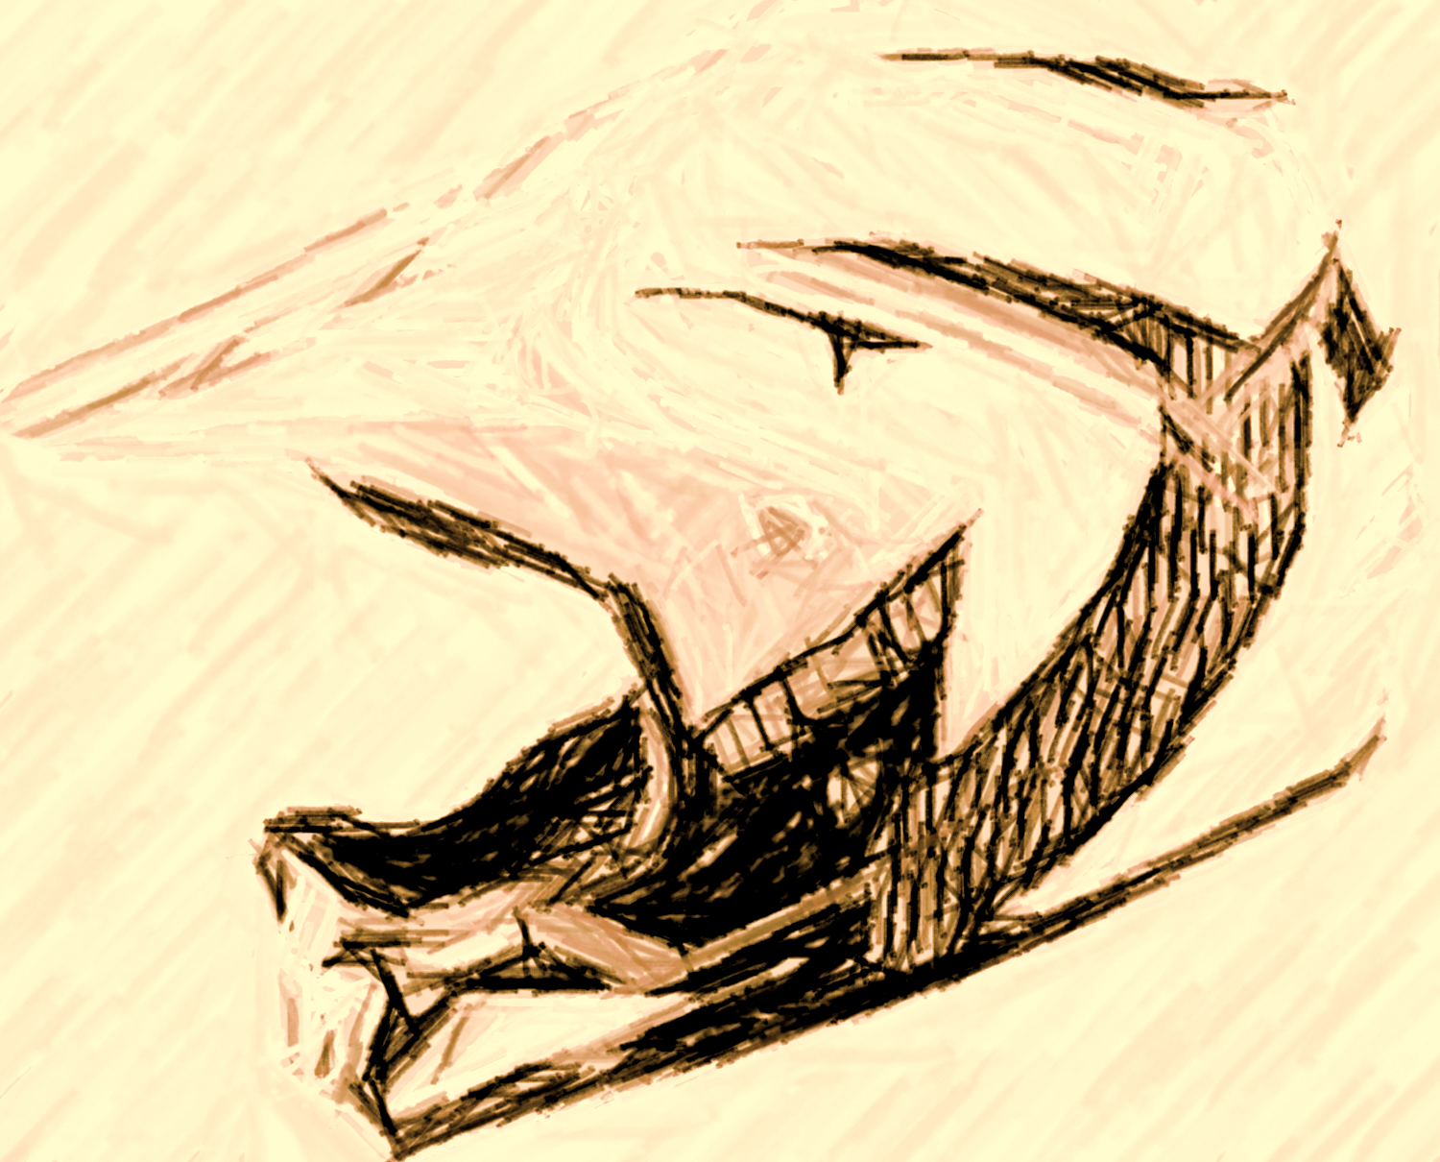
YOU CANNOT PLAY IT SAFE AND PLEASE GOD
it is impossible to please God without faith Hebrews 11:6 NLT

Slide 13
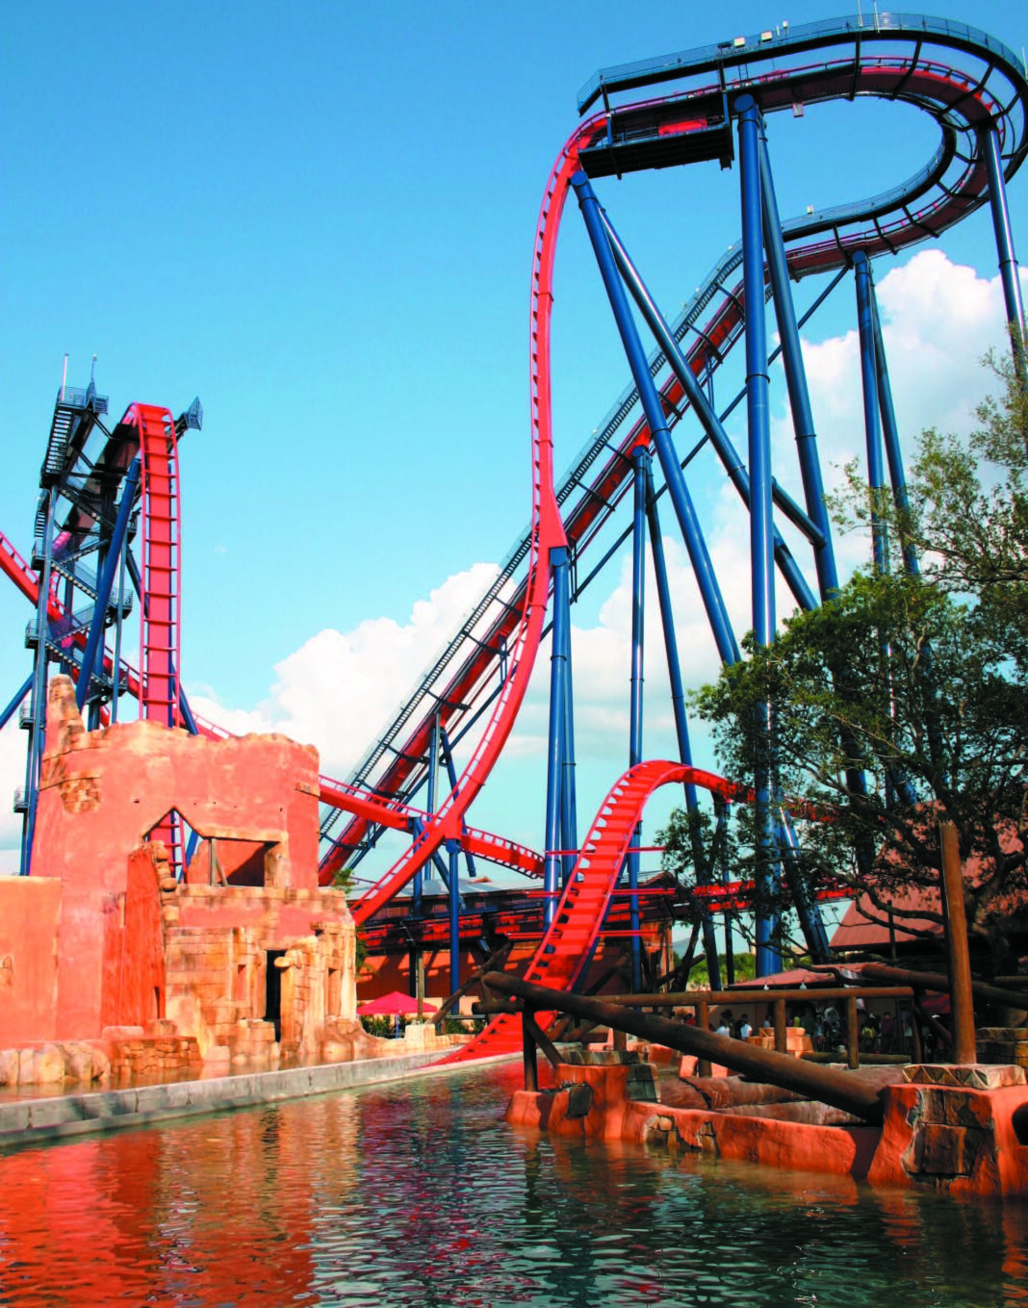
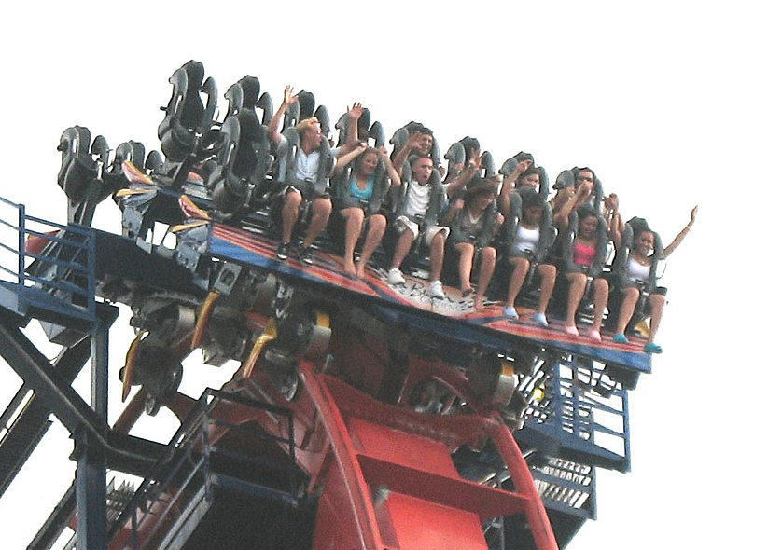

Slide 14
