Slide 1


Slide 2
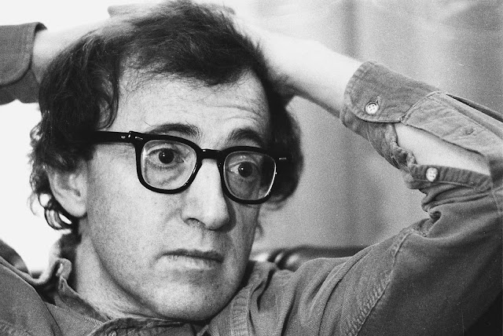
“if yoU Are not failing every now and again, It is a sign you are not doing anything very innovative.” Woody ALLEN

Slide 3

As long as you have a guarantee,
you do not have faith.
Faith shows the reality of what we hope for Hebrews 11:1 NLT

Slide 4


Slide 5
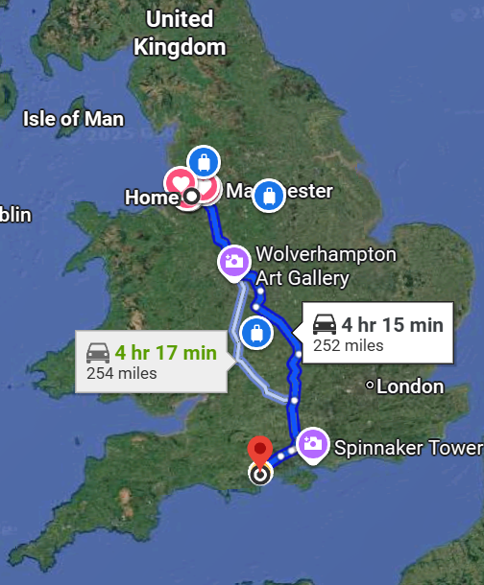

Slide 6

Faith shows the reality of what we hope for; it is the evidence of things we cannot see. Hebrews 11:1 NLT

Slide 7
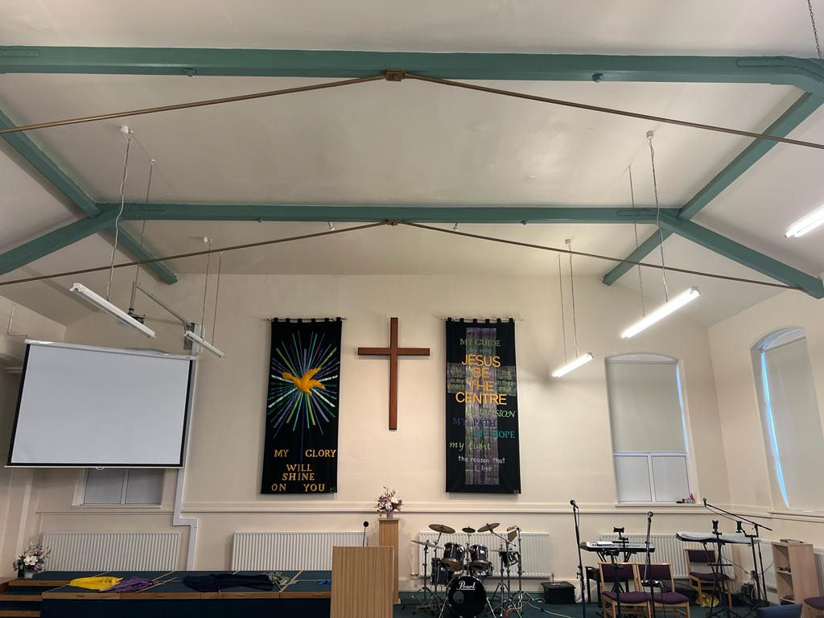




Slide 9

to step toward our destiny, we have to step away from our security

Slide 10

This Photo by Unknown Author is licensed under CC BY-SA

