Slide 1
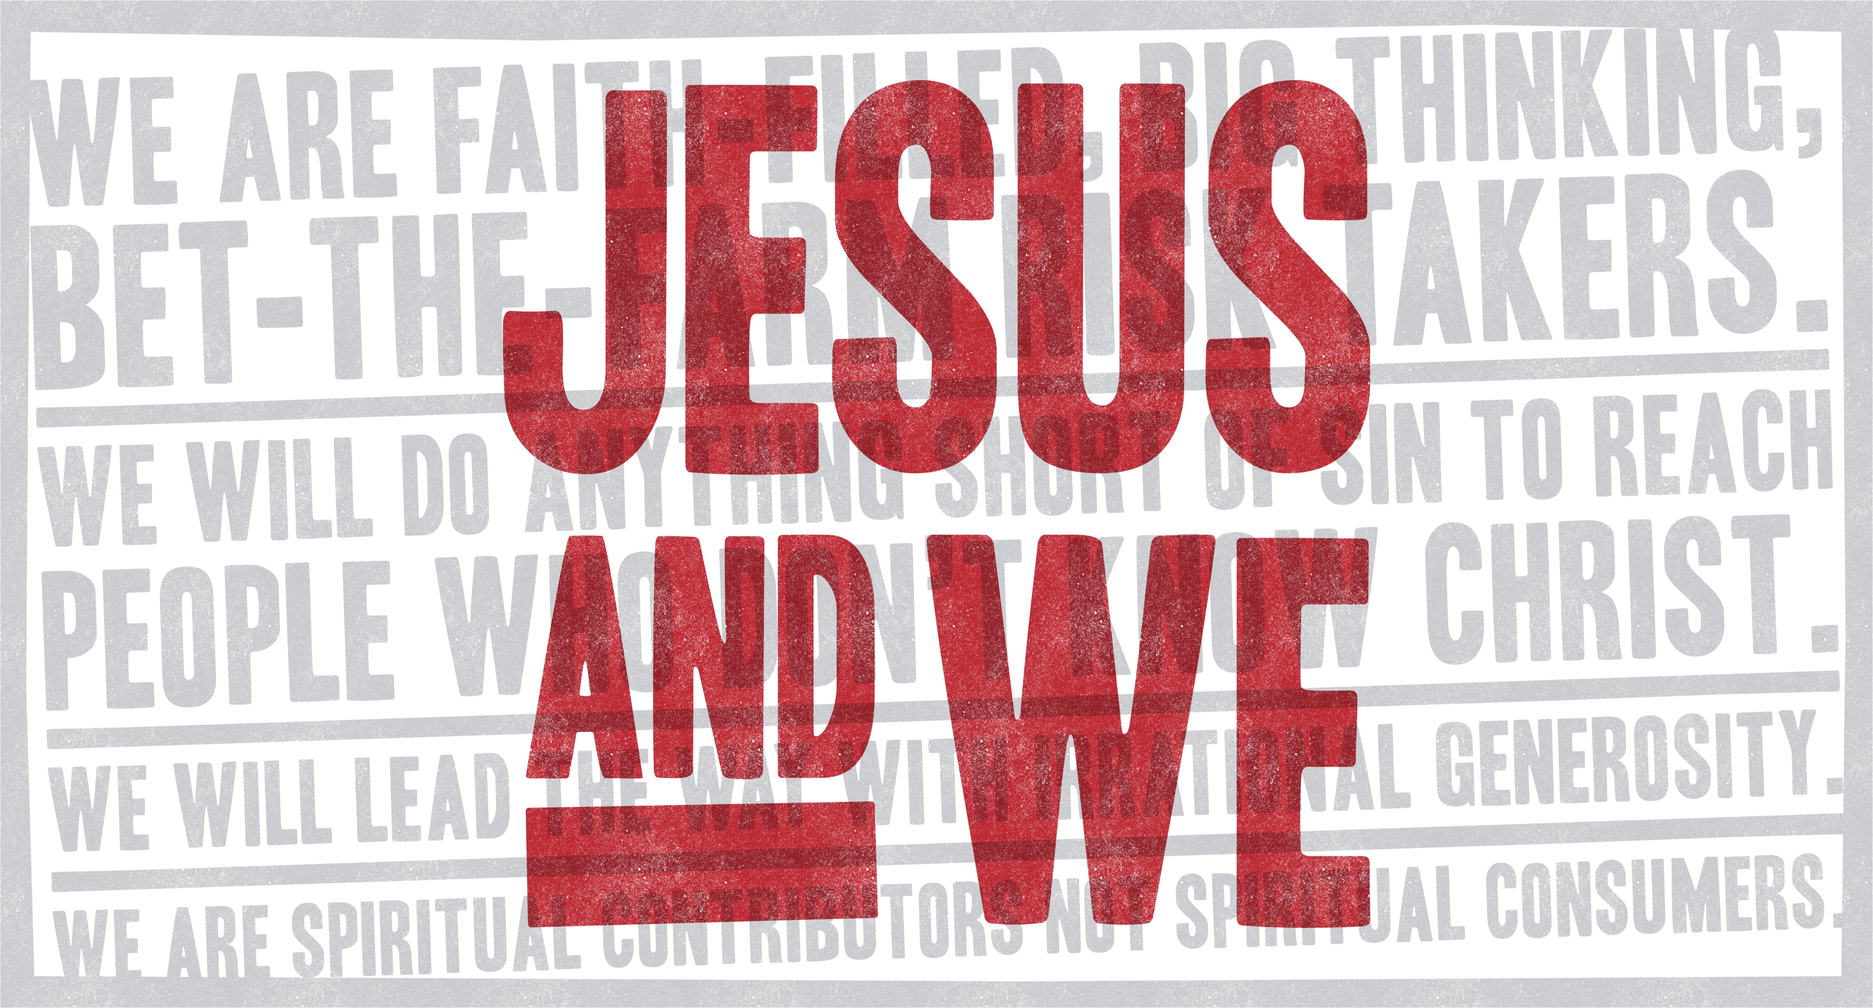

Slide 2
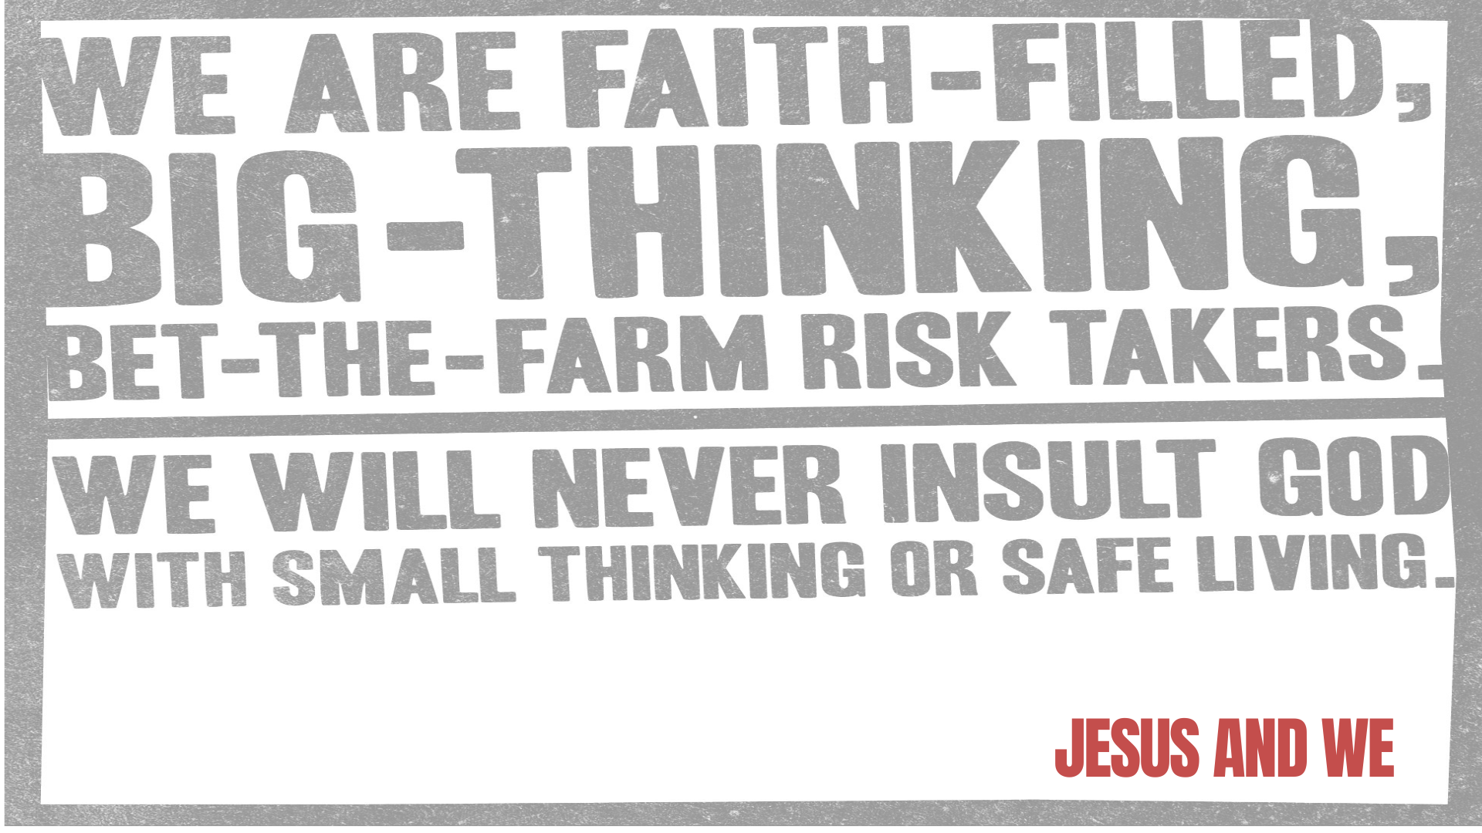

Slide 3
What specific fears or doubts hold you back from complete faith in God? What could help you strengthen that trust?
What securities could be keeping you from your destiny? How determined are you to let go of them?
What are we doing as a group that requires faith-filled, big-thinking, bet-the-farm risk-taking? What else can WE do?

Slide 4


Slide 5
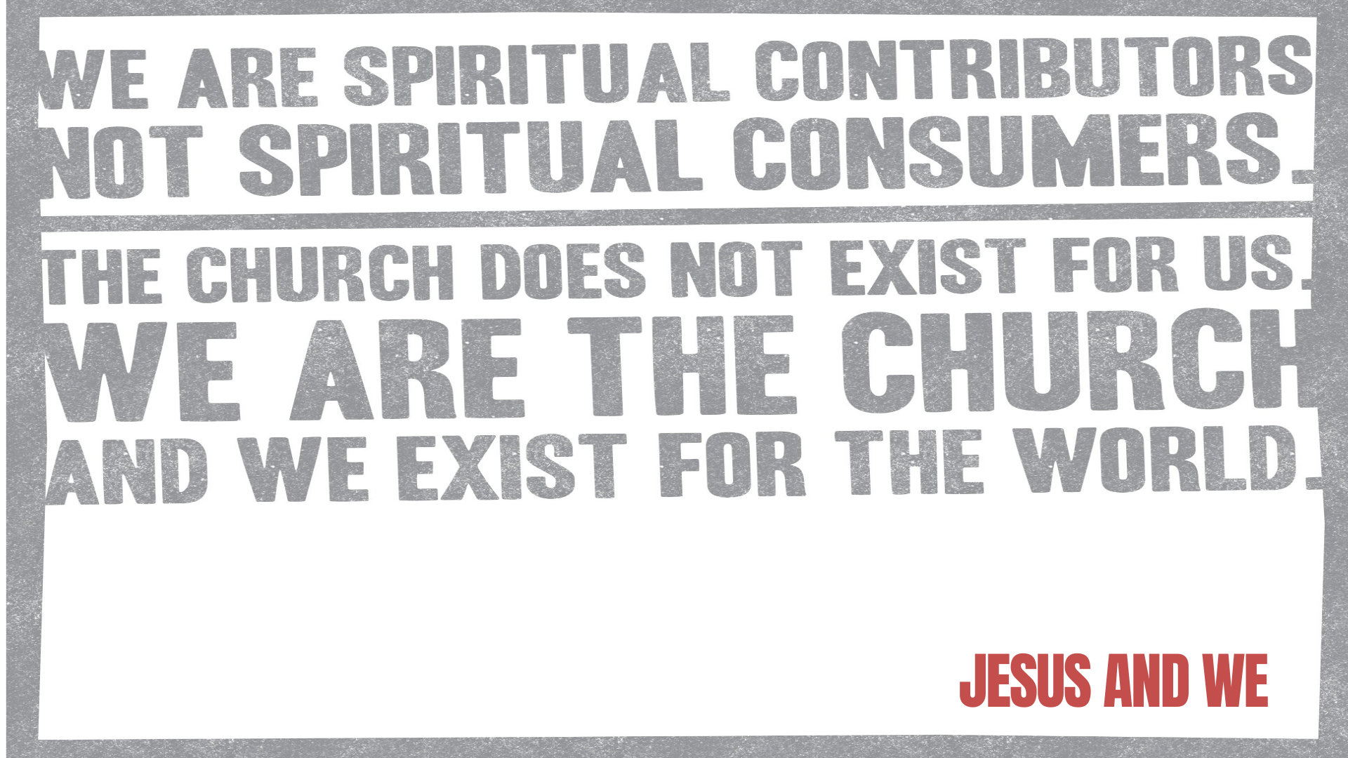

Slide 6
What skills are there on your table?
Servers, Teachers, Encouragers, Givers, Leaders, Kind-ers (?), Prophets
“You are the light of the world” – those are Jesus’ words about you. How does that play out in your life?
Share how you have been served and loved by our church. How will you match or surpass what you’re receiving?

Slide 7



Slide 8
What do you like about our church that you could share with others?
Share what got you to come to SVC for the first time. What tactics could we apply to how we can be more effective at bringing others with us?
How could you start a dialogue with a family member or friend who you haven’t shared Jesus with before?

