Slide 1
Praise and Worship

Slide 3
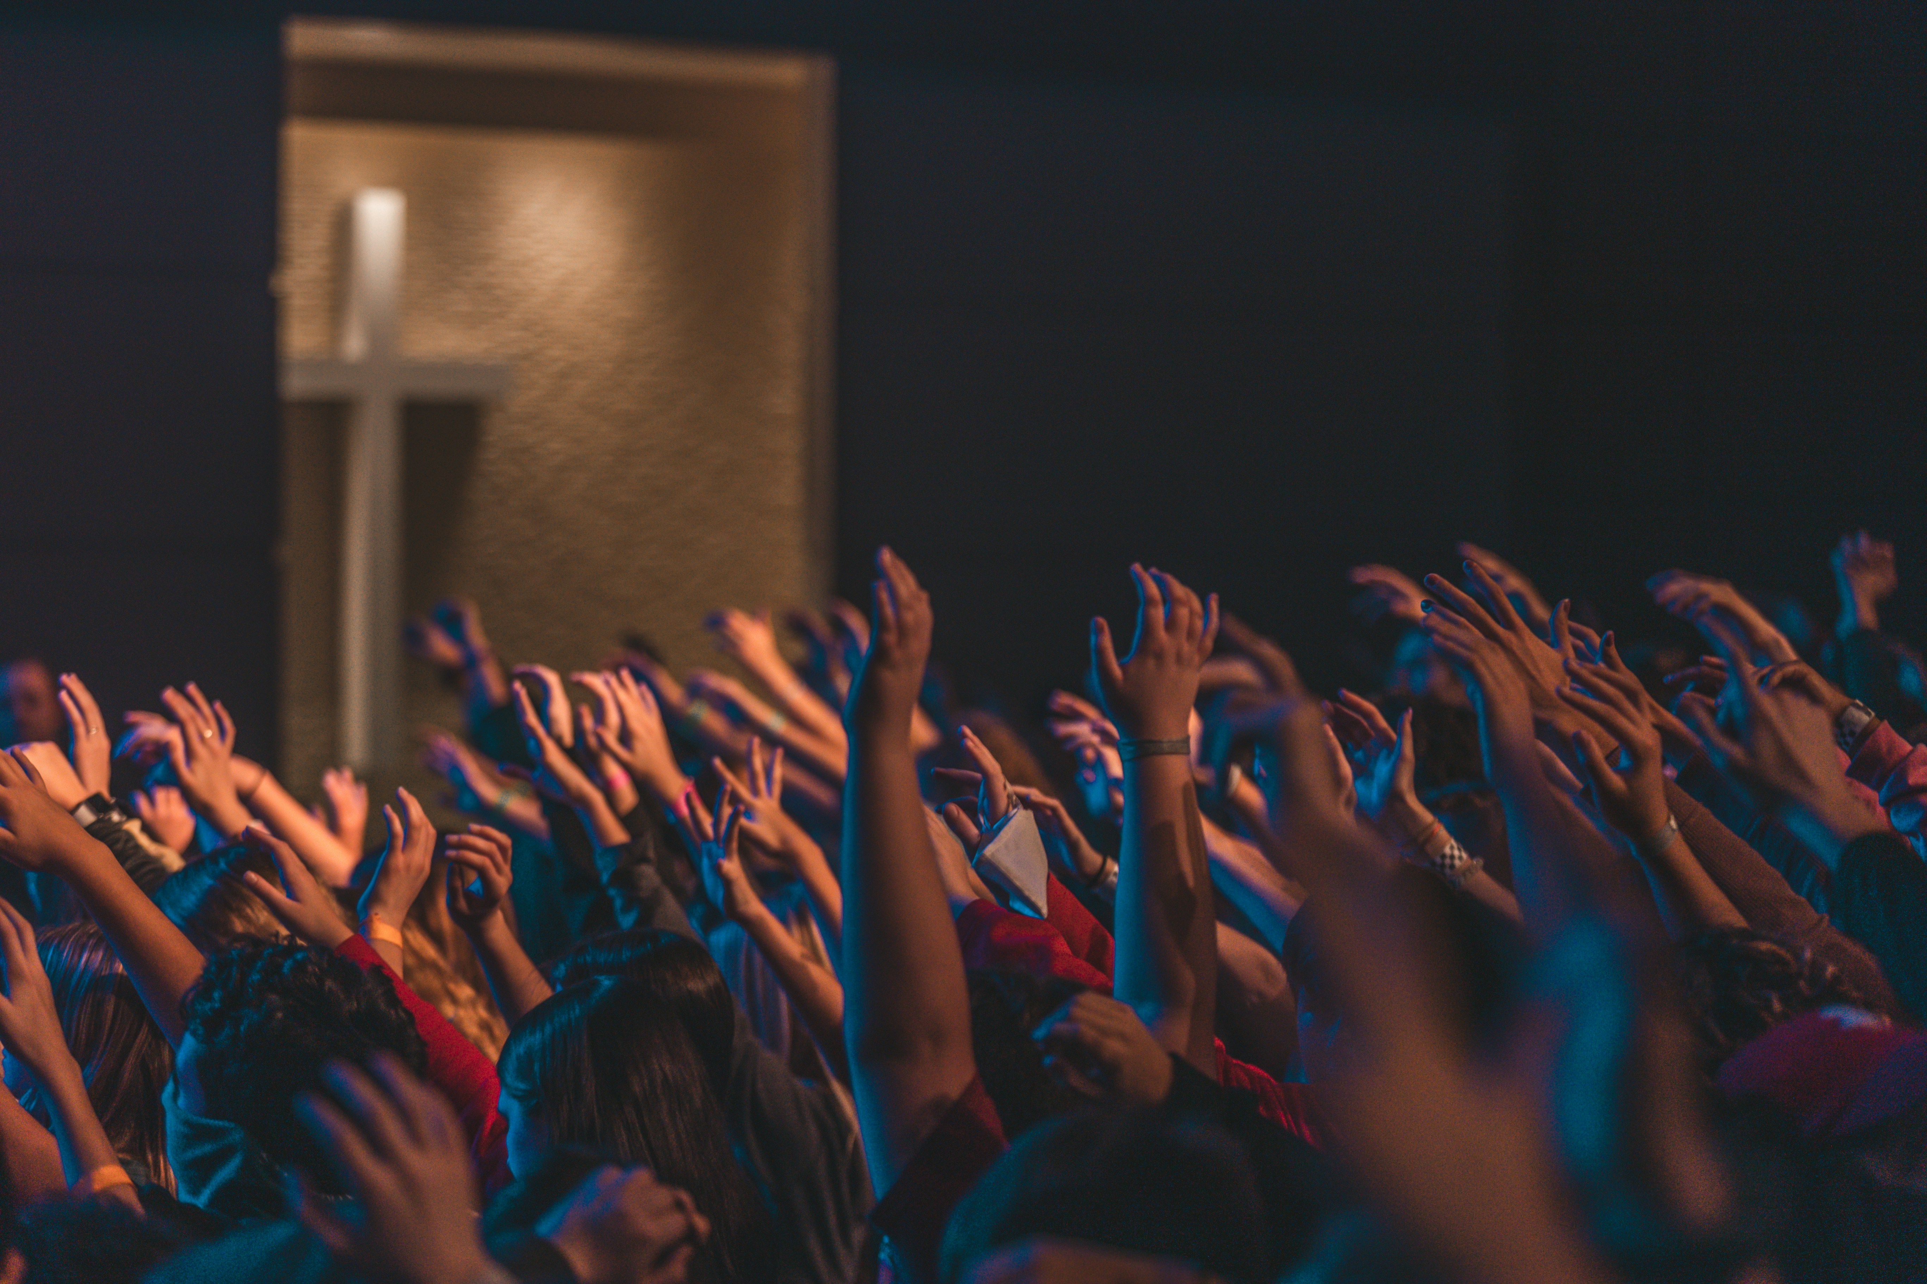

Slide 4
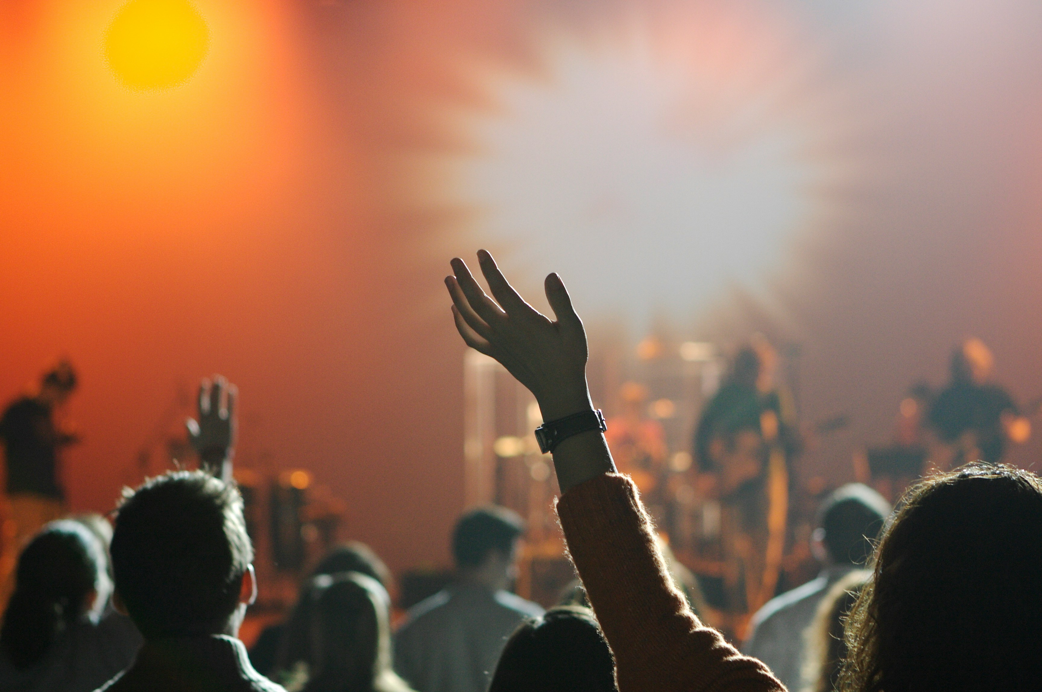

Slide 5
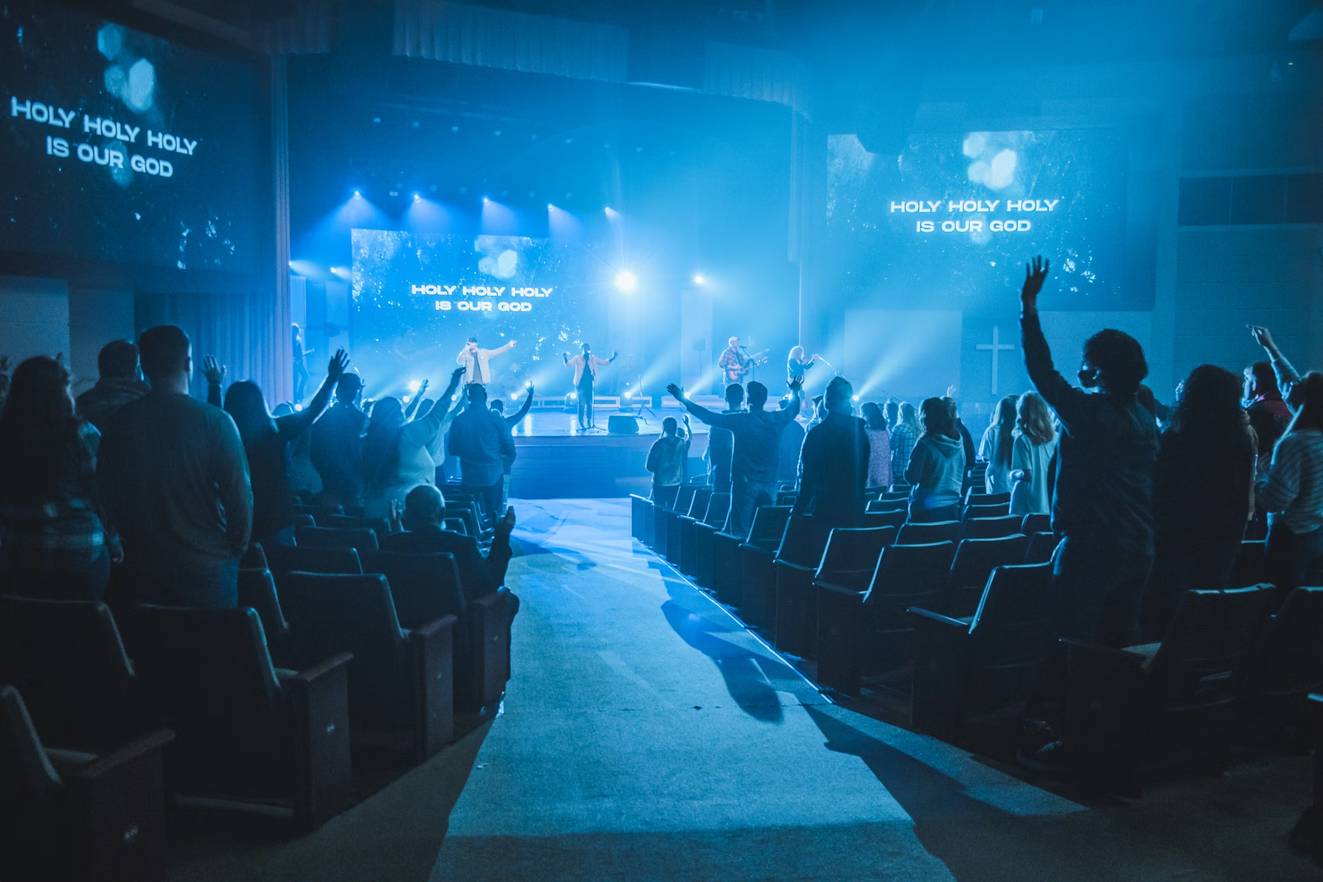

Slide 6
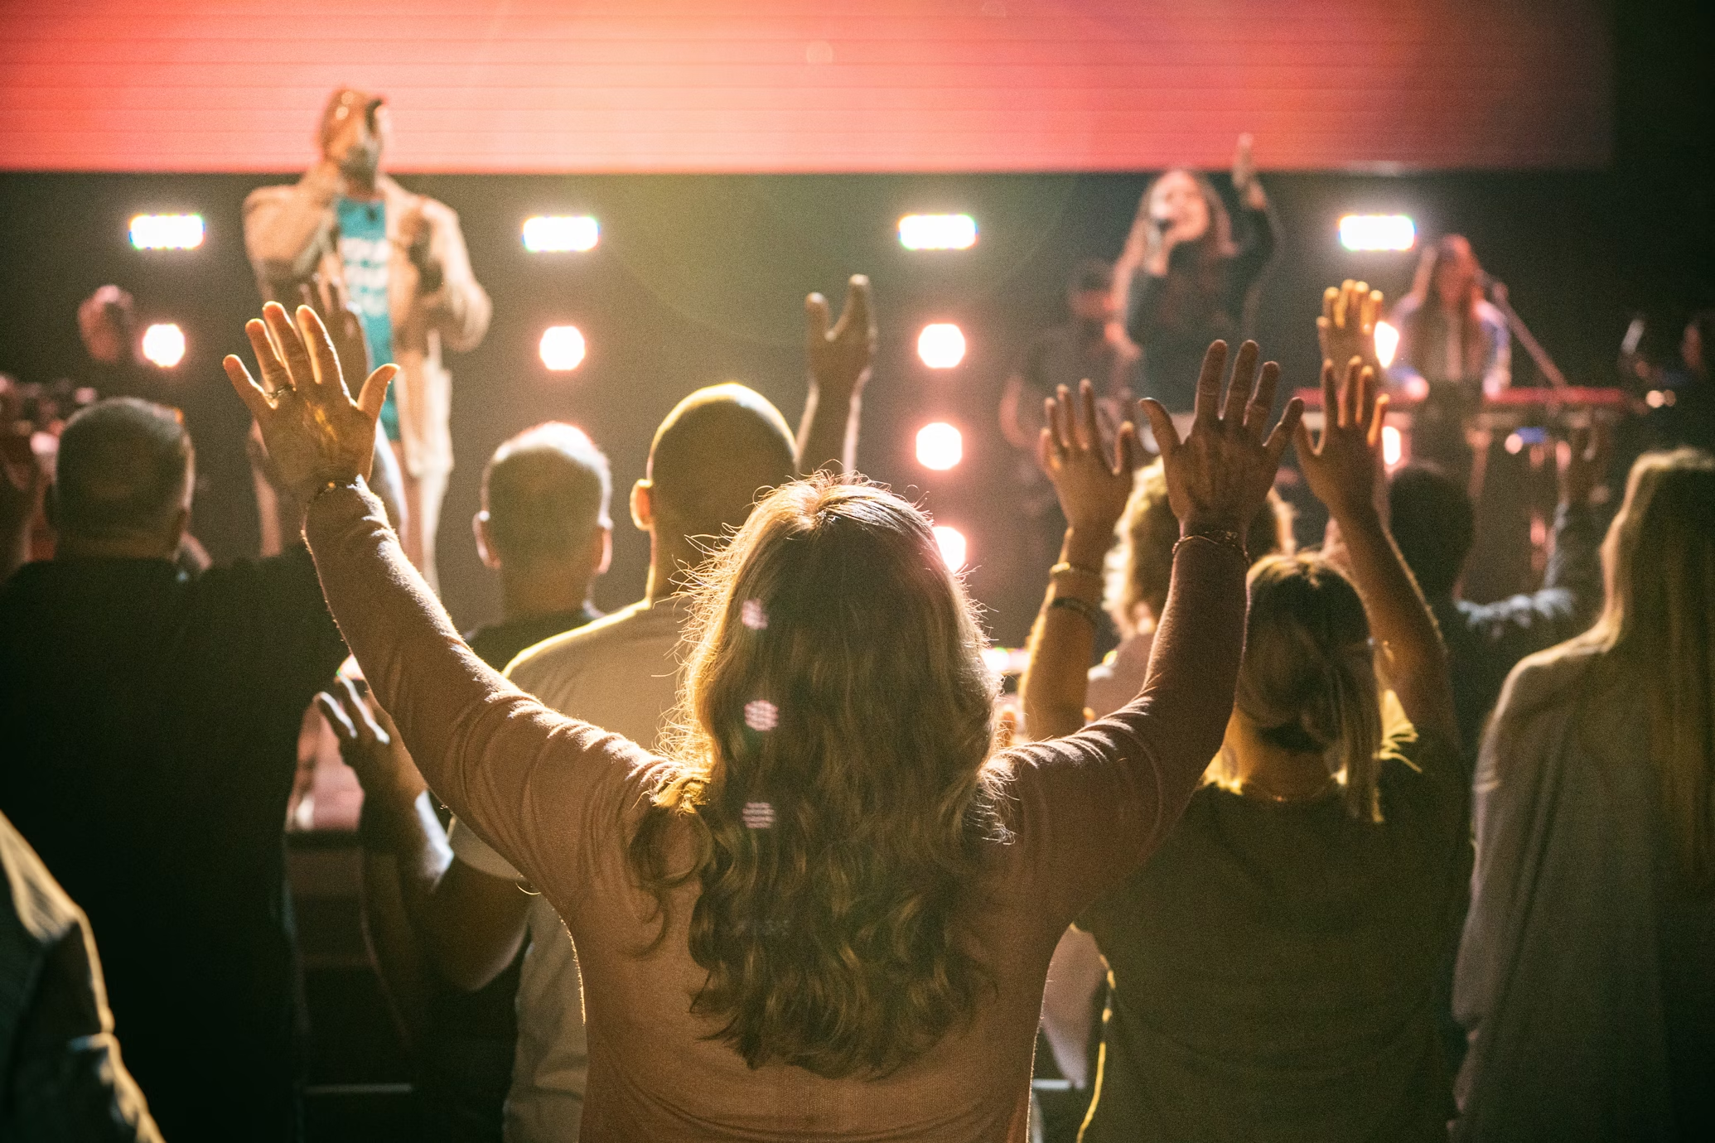

Slide 7
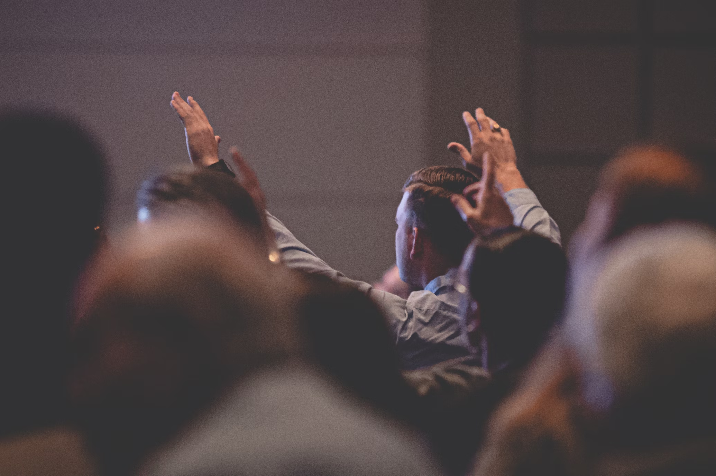

Slide 8
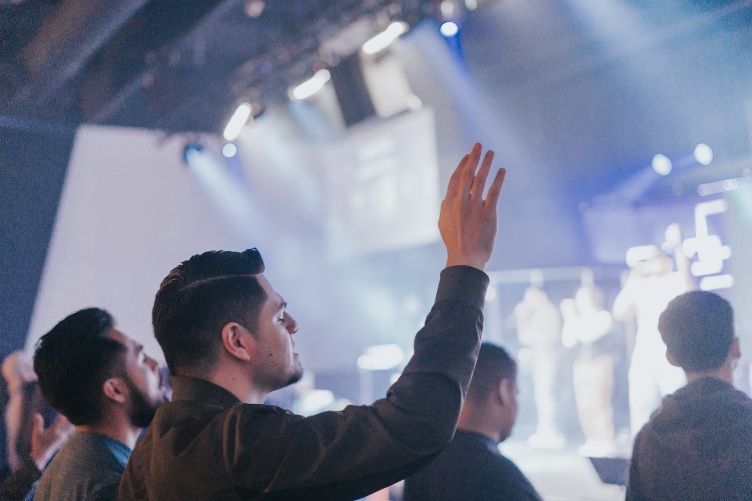

Slide 9
Is This It…?

Slide 10
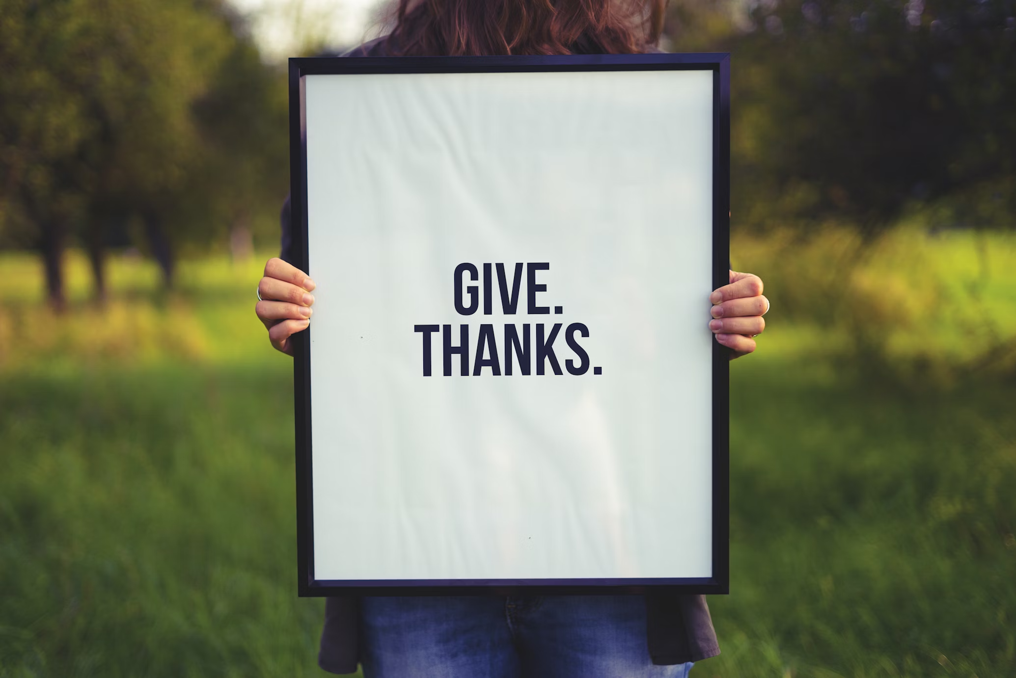
What Is Praise?
Enter his gates with thanksgiving and his courts with praise; give thanks to him and praise his name. Psalm 100:4

Slide 11
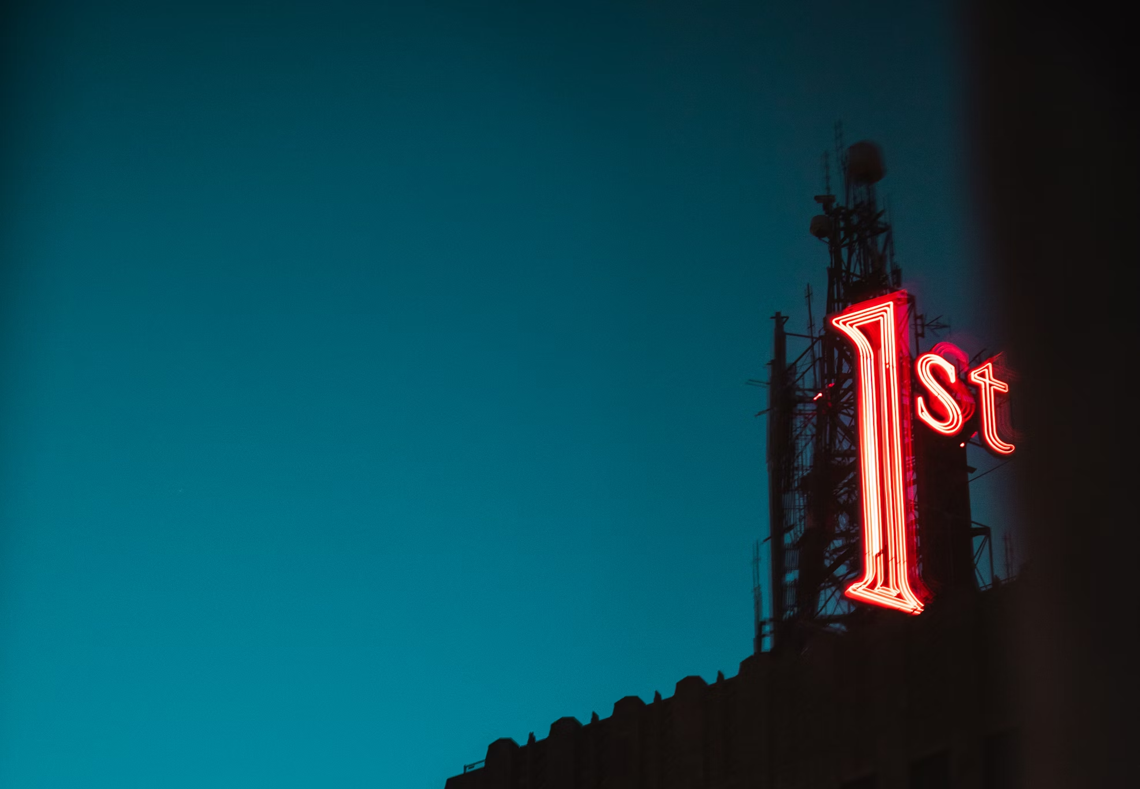
What Is Worship?
“You shall have no other gods before me.”
Exodus 20:3

Slide 12
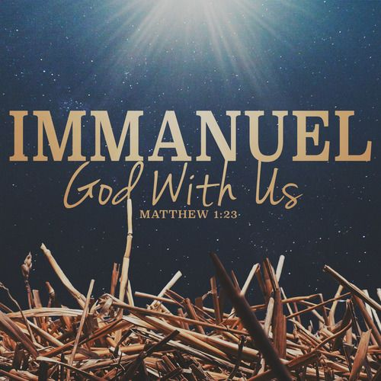

Slide 13
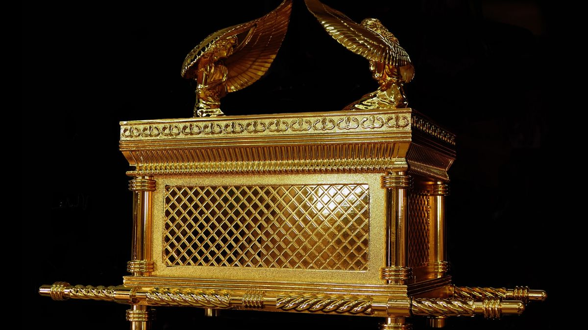
The Ark

Slide 14
The Ark
Construction - Exodus 37:1-9

Slide 15
The Ark
Construction - Exodus 37:1-9
Contents - Hebrews 9:4b

Slide 16
The Ark
Construction - Exodus 37:1-9
Contents - Hebrews 9:4b
Temple of Dagon - 1 Samuel 5

Slide 17
The Ark
Construction - Exodus 37:1-9
Contents - Hebrews 9:4b
Temple of Dagon - 1 Samuel 5
Abinadab’s House – 1 Samuel 7

Slide 18
The Ark
Construction - Exodus 37:1-9
Contents - Hebrews 9:4b
Temple of Dagon - 1 Samuel 5
Abinadab’s House – 1 Samuel 7
David Wants It Back – 2 Samuel 6

Slide 19
The Ark
Construction - Exodus 37:1-9
Contents - Hebrews 9:4b
Temple of Dagon - 1 Samuel 5
Abinadab’s House – 1 Samuel 7
David Wants It Back – 2 Samuel 6
Do It God’s Way – 2 Samuel 6:1-10

Slide 20
The Ark
Construction - Exodus 37:1-9
Contents - Hebrews 9:4b
Temple of Dagon - 1 Samuel 5
Abinadab’s House – 1 Samuel 7
David Wants It Back – 2 Samuel 6
Do It God’s Way – 2 Samuel 6:1-10
Obed Edom – 2 Samuel 6:10-11

Slide 21
The Ark
Construction - Exodus 37:1-9
Contents - Hebrews 9:4b
Temple of Dagon - 1 Samuel 5
Abinadab’s House – 1 Samuel 7
David Wants It Back – 2 Samuel 6
Do It God’s Way – 2 Samuel 6:1-10
Obed Edom – 2 Samuel 6:10-11
Do It The Right Way – 2 Samuel 6:12-19

Slide 22
The Ark
Construction - Exodus 37:1-9
Contents - Hebrews 9:4b
Temple of Dagon - 1 Samuel 5
Abinadab’s House – 1 Samuel 7
David Wants It Back – 2 Samuel 6
Do It God’s Way – 2 Samuel 6:1-10
Obed Edom – 2 Samuel 6:10-11
Do It The Right Way – 2 Samuel 6:12-19
Criticism – 2 Samuel 6:20-23

Slide 23
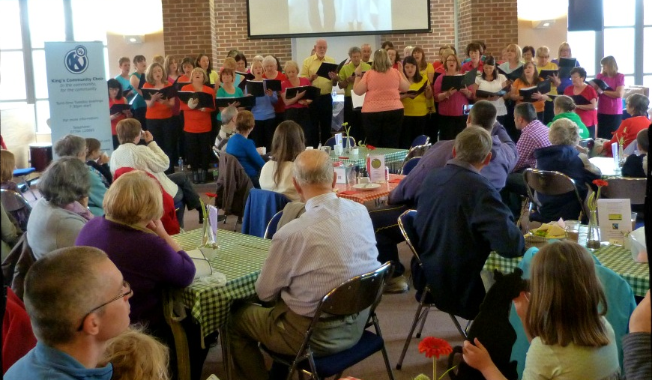

Slide 24
Reminder
Praise is about our gratitude to God. What has He done, who is He, what is He like?
Worship is about the place that God holds in our lives. It’s about putting Him first in our thinking, our decisions, our actions and intimacy with Him.
Worship God in the way the He tells us to - with passion, more concerned about Him than how others see us.
Sung Worship is powerful. Let’s practise!

Slide 25
Alto
Great is He who’s the King of Kings
And the Lord of Lords, He is wonderful
Soprano
Alleluia, Alleluia, Alleluia
He is wonderful
Men
Alleluia, salvation and glory
Honour and power, He is wonderful

