Slide 1

LifeGroups | Disciples are Learners

Slide 2


Slide 3
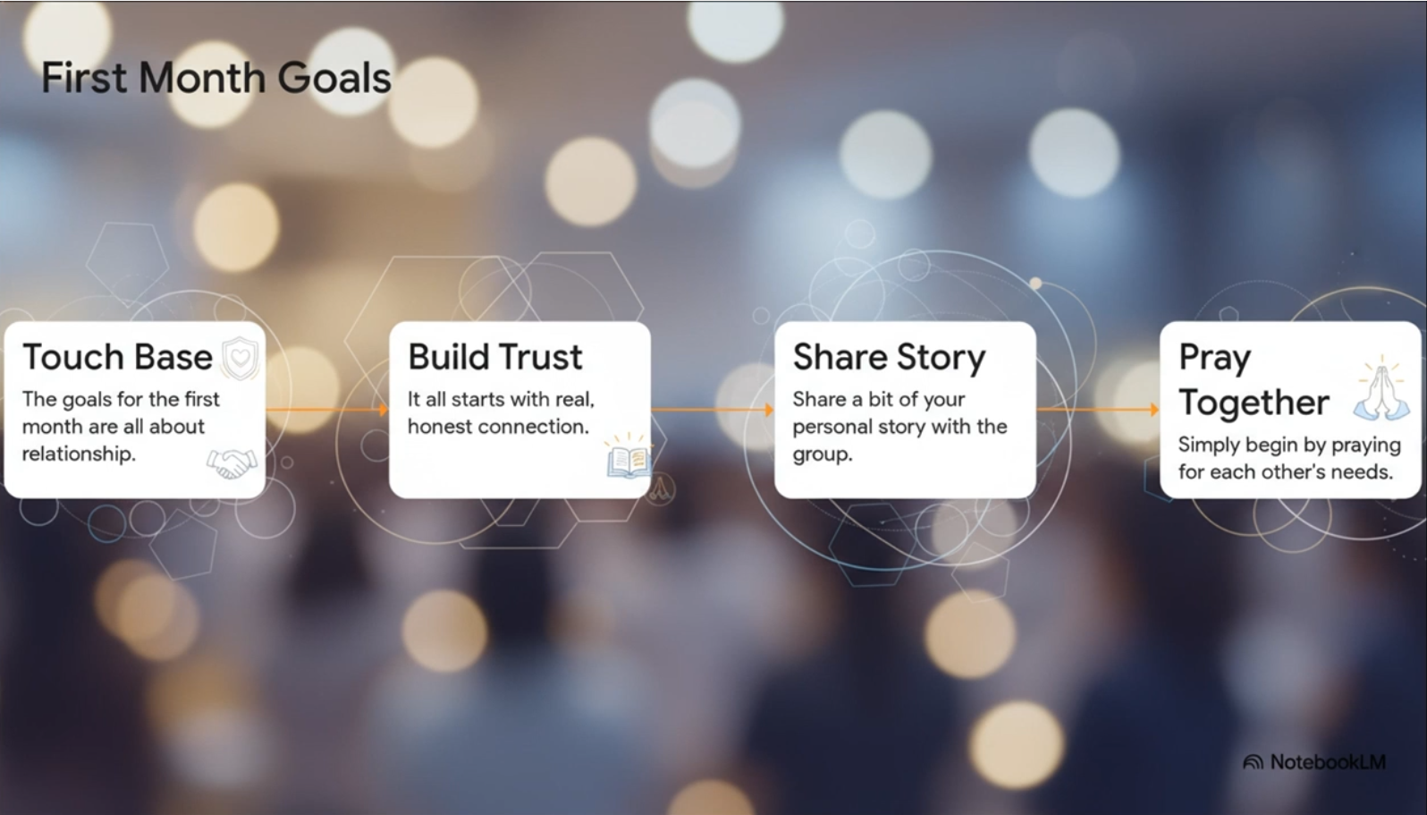
Month One Goals
How is it going so far?

Slide 4

LifeGroups
Disciples are Learners.
Disciples are Followers.
Disciples are Messengers.

Slide 5
What was the number one word used to describe Jesus?

Slide 6
Teacher
“You call me Teacher and Lord, and you are right, for so I am.” John 13:13
We discover who we are by responding to who He is.

Slide 7
LifeGroups
Because Jesus is the Teacher, we are called to be Learners.
The first role of a disciple is to be a learner.

Slide 8
Why is it significant that people called Jesus “Teacher” during His earthly ministry?
How does acknowledging Jesus as our teacher shape our approach to discipleship?

Slide 9
Why Learn?
“A disciple is not above his teacher, but everyone when he is fully trained will be like his teacher.” Luke 6:40 ESV
According to this verse, what is the ultimate goal of being a learner of Jesus?

Slide 10
It’s About Becoming Like Jesus
“A disciple is not above his teacher, but everyone when he is fully trained will be like his teacher.” Luke 6:40 ESV
We don’t just learn from Him; we learn Him.
We start with Jesus and then build our entire lives around…
  His Words
  His Works
  His Ways

Slide 11
The Invitation: Follow Me
A Three-Step Process for Growth…
1. Spend Time
2. Listen and Learn
3. Become Like Him

Slide 12

Step 1: Spend Time With Him
In the first century, the command “Follow Me” was not a metaphor. It meant literally walking in the Rabbi’s dust. It required physical proximity.
The Modern Application
You cannot learn from a teacher you are never with. The foundation of a learner’s role is intentionally putting yourself in His presence on a regular basis.

Slide 13
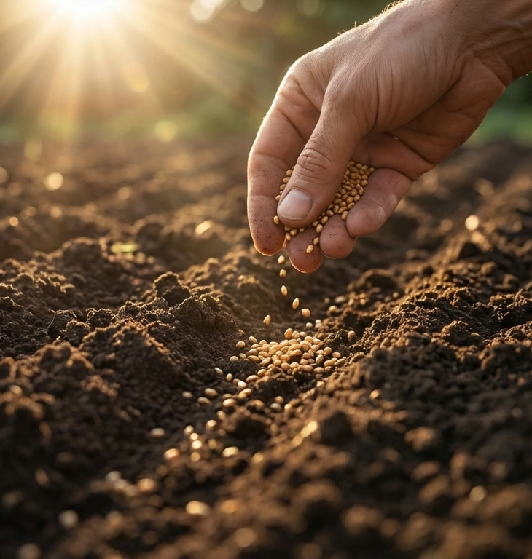
Step 2: Listen and Learn
Following meant paying attention. A disciple must “be on the alert,” studying His words, works and ways.
In the Parable of the Sower, Jeus taught that only those who listen, receive, and act on His teachings possess true faith.

Slide 14

Step 3: Become Like Him
“Follow me and I will make you fishers of men.” Mathew 4:19
The result of true learning is transformation. Jesus was fishing for men like Andrew and Peter. He promised that if they followed, they would eventually do exactly what He was doing.
We learn in order to mirror the Master.

Slide 15
What are some challenges you face in consistently being a learner of Jesus?
How can we support each other in overcoming these challenges and growing as learners?

Slide 16
What can we do within our LifeGroups to learn more about Jesus?

Slide 17

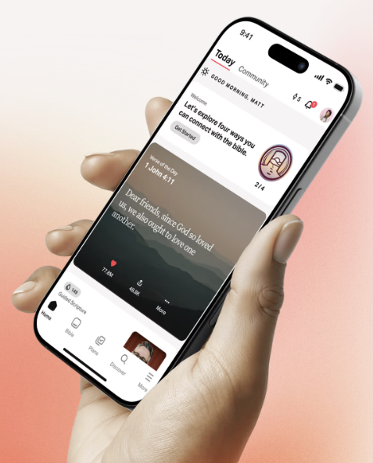
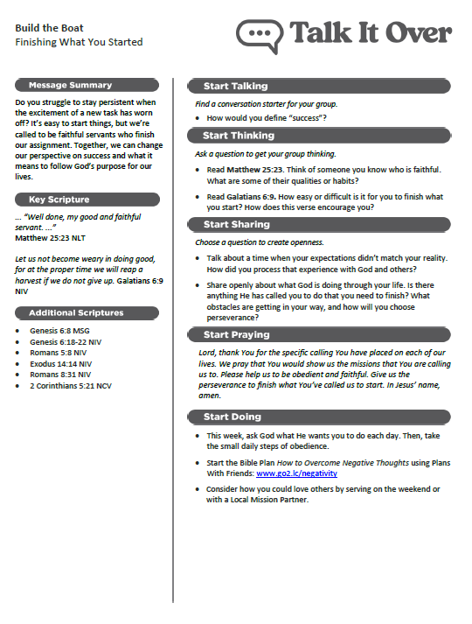
LifeGroups

Slide 18
The 3 Levels of Learning
Internalise
Putting into practice to change character
Externalise
Paying it forward by teaching others
Informational
Gaining knowledge through daily engagement
We do not graduate from discipleship. We simply go deeper from head knowledge, to life application, to transmission.

Slide 19

The H.E.A.R Journal
This is the primary tool used in our LifeGroups. It is a method to read the bible with the specific intention of applying it.
3x
Writing helps you retain 3x more of what you read than reading alone.

Slide 20
The H.E.A.R. Journal
H - HIGHLIGHT
Write down the specific verse or verses that stood out during your reading.
E - EXPLAIN
Briefly explain the author’s intended meaning and the context.

Slide 21
The H.E.A.R. Journal
A - APPLY
Identify a specific principle from the text that can be lived out today.
R - RESPOND
How will I respond to the application in my relationships and/or situations this week?

Slide 22
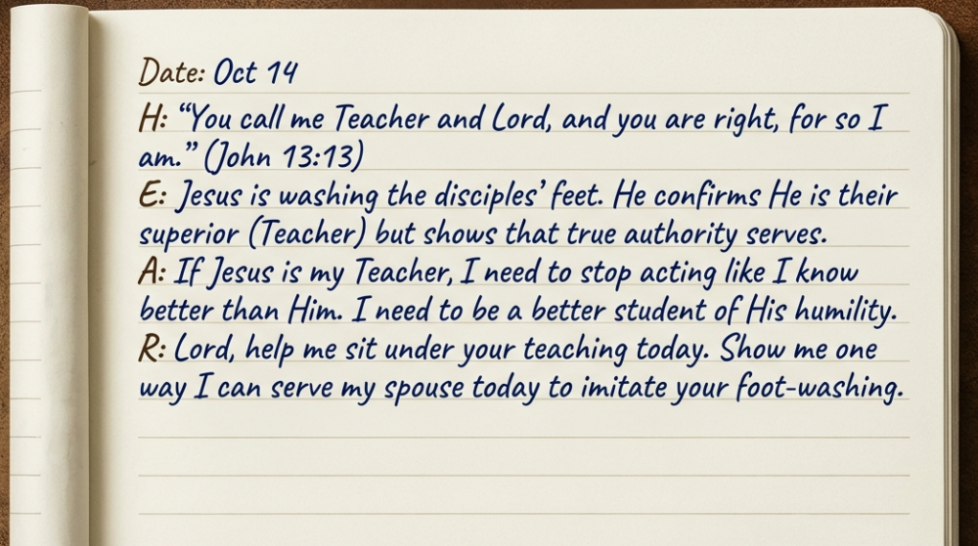
Sample Entry

Slide 23
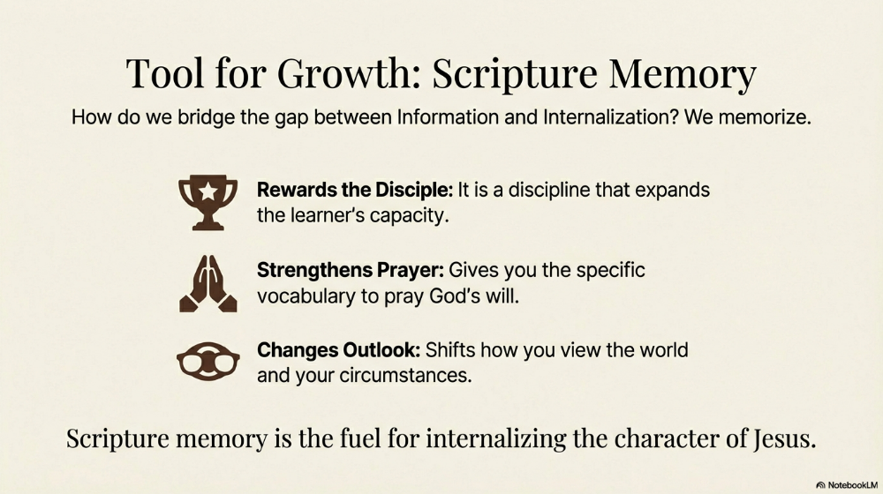
Tool for Growth: Scripture Memory
How do we bridge the gap between informational and internalisation? We memorise.
Scripture memory is the fuel for internalising the character of Jesus

Slide 24
Month 2 Goals
Accept the Identity: Jesus is the teacher, you are the learner.
1
Trust the Process: Spend time, listen, and become like Him.
2
Start the practice: Start using your H.E.A.R Journal.
3
Start the practice: Start memorising scripture.
4
Join a LifeGroup | Live a Life of Devotion to Jesus

